Slide 1
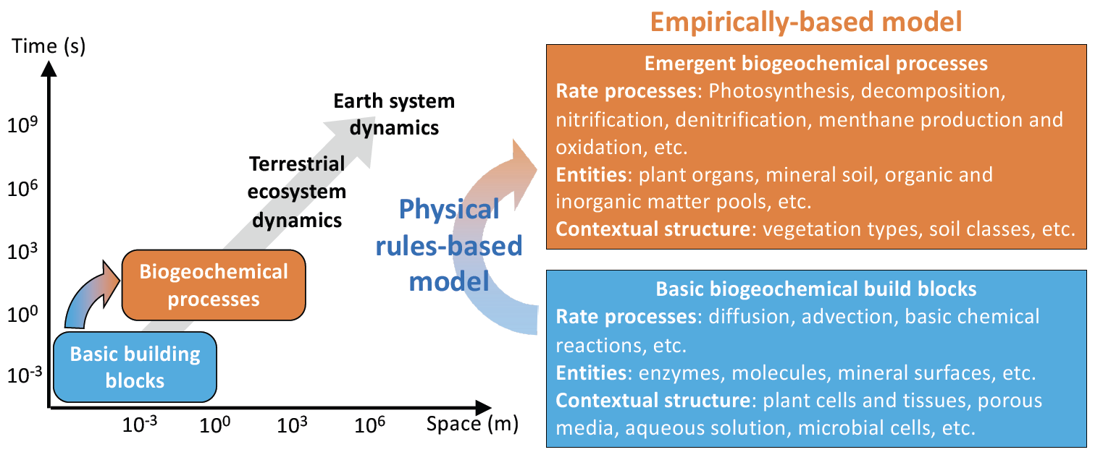
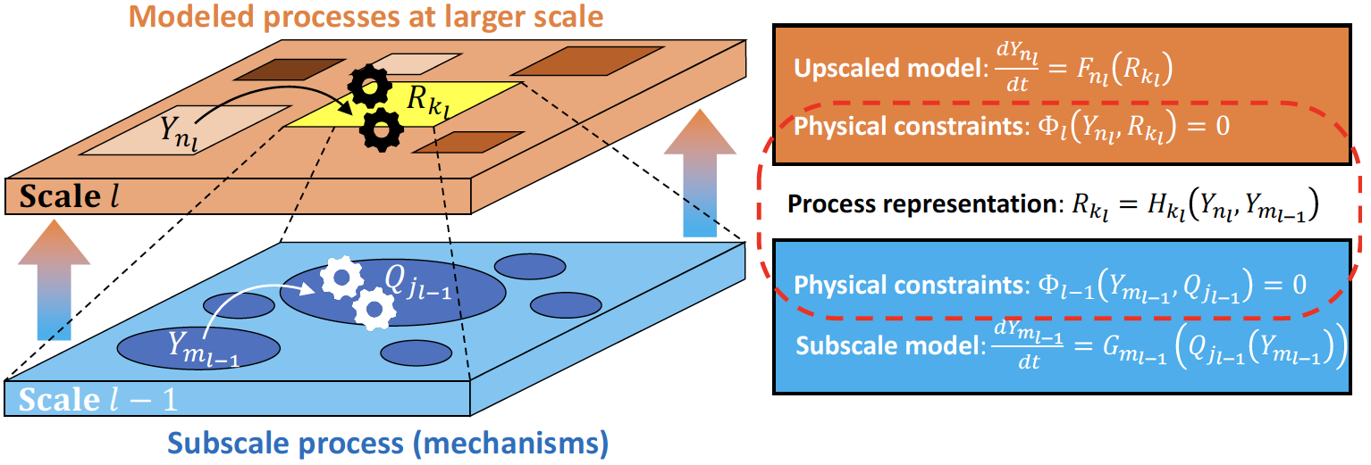
A new paradigm for improving ecosystem biogeochemistry models
Scientific Challenges
Current empirically-based ecosystem models suffer from parametric uncertainty and poor spatial-temporal extrapolation capability
Approach and Results
We discuss limitations of the multiplicative empirical approaches for limitations and the law of the minimum model that are widely used in current ecosystem biogeochemical models
To address these issues, we propose the physical rules-based approach
Combined with the Bayesian framework, we explain how more accurate and robust ecosystem biogeochemical models can be developed
Figure 1. Current empirically-based ecosystem biogeochemical models are insufficient in depicting interactions among biogeochemical processes. Physical rules based models can better tackle this challenge.
Significance
The new paradigm could better serve to:
Guide development of new ecosystem biogeochemical models
Improve model-experiment integration
Figure 2: By considering scale interactions between fine- and coarse-scale processes, physical rules-based models will be more robust than existing empirically-based models.
Citation: J.Y. Tang, Riley, W.J., Manzoni S., and Maggi, F (2024) Feasibility of formulating ecosystem biogeochemical models from established physical rules, JGR-Biogeosciences, https://doi.org/10.1029/2023JG007674.

