Slide 1
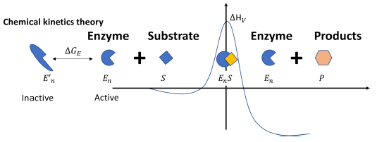
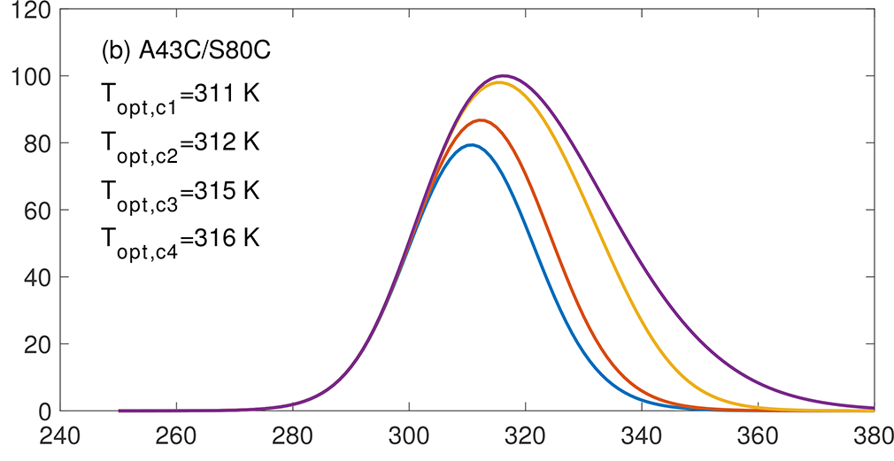
New Theory Resolves the Non-Monotonic Temperature Response of Biogeochemical Reaction Rates
Scientific Challenges
No current theory concurrently describes the temperature dependence of the affinity parameter and the maximum reaction rates of substrate kinetics.
Approach and Results
Figure 1. In the chemical kinetics theory, the Gibbs free energy of activation $∆G_{V}$ is a linear function of temperature, i.e., $∆G_{V}=∆H_{V}−T∆S_{V}$, with the enthalpy of activation $∆H_{V}$ and the entropy of activation $∆S_{V}$ both being constant. This behavior of $∆G_{V}$, along with the
thermally reversible denaturation of the enzymes (as depicted by the inactive and active states), leads to the non-monotonic temperature response of the catalysis rate.
A chemical kinetics theory was developed by combining: (1) law of mass action, (2) von Smoluchowski's diffusion-limited chemical reaction theory, and (3) Eyring’s transition state theory.
This theory reveals that (1) the reversible transition between active and inactive enzyme states leads to a non-monotonic temperature dependence of biogeochemical reaction rates; and (2) the affinity parameter’s temperature dependence follows the Arrhenius function.
Significance
The theory predicts that the apparent optimal temperature of a biochemical reaction can
Increase with substrate availability
Be affected by substrate type
Figure 2: with increasing substrate availability, apparent optimal temperature becomes higher.
Citation: Tang, J. and Riley, W. J.: A chemical kinetics theory for interpreting the non-monotonic temperature dependence of enzymatic reactions, Biogeosciences, 21, 1061–1070, https://doi.org/10.5194/bg-21-1061-2024, 2024.

