Slide 1
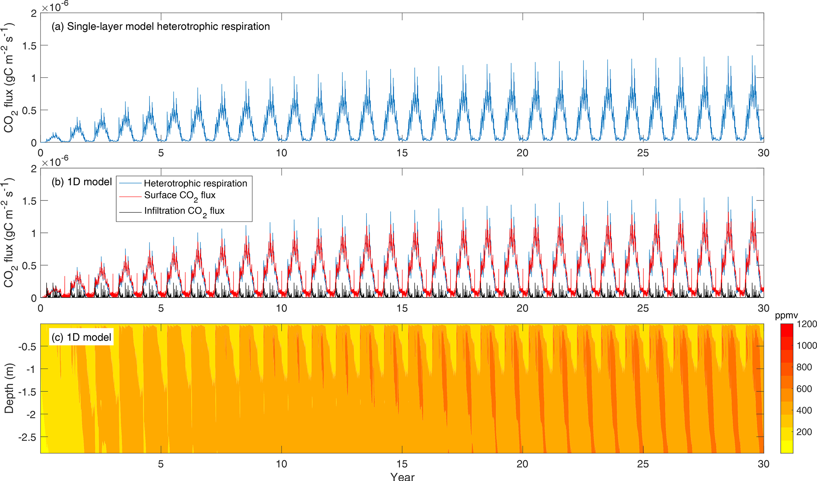
BeTR-v2 for Robust Biogeochemical Modeling
Scientific Challenges
Robust biogeochemical modeling needs robust numerical implementation.
Structural uncertainty assessment of biogeochemistry is conflated with non-biogeochemical model components.
Approach and Results
Developed BeTR-v2 to support robust implementation of diverse biogeochemical formulations with benchmarked numerical methods.
Allow the same biogeochemical model to be run as standalone single layer, 1D soil column, and coupled with ELM.
Significance
Figure. (a) Heterotrophic CO₂ flux simulated by the 10 cm thick single-layer model. (b) Column-integrated flux, soil surface CO₂ flux (from capillary exchange and diffusion considering equilibrium between gaseous and aqueous phases), and CO₂ infiltration flux. (c) Evolution of soil CO₂ concentration corresponding to panel (b).
We benchmarked the transport solver of BeTR-v2 with analytical solutions, and found excellent agreement.
We implemented ELM-v1 with BeTR-v2, and found different numerical methods significantly influence simulated biogeochemistry dynamics.
We showed that calibration cannot resolve biases introduced by improper numerical implementation, highlighting the need for robust solvers.
Ciation: Tang, J.-Y., Riley, W. J, and Zhu, Q.: Supporting hierarchical soil biogeochemical modeling: version 2 of the Biogeochemical Transport and Reaction model (BeTR-v2). (2022)., Geosci. Model Dev., 15, 1619–1632, 2022 https://doi.org/10.5194/gmd-15-1619-2022.

