Slide 1
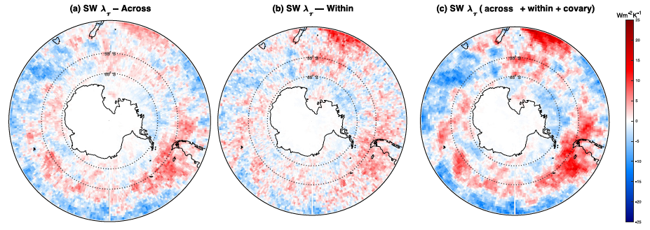
Contributions from Cloud Regime Changes to the Observed Cloud Feedback
Science Question
Models typically simulate a negative cloud feedback over the Southern Ocean, but observations suggest that it may be closer to zero.
What processes contribute to this cloud feedback in nature?
Key Accomplishments
The team applied a novel method that teases apart contributions from changing cloud properties (e.g., spatial coverage, reflectivity) to the cloud feedback, and then further dissects each of these contributions into those arising from cloud property changes within cloud regimes and changes in the relative populations of each regime.
Impact
The team found that increases in surface wind speed increase the reflectivity of low- and mid-level cloud regimes over the Southern Ocean. Simultaneously, an overall shift from thicker to thinner cloud regimes tends to oppose this, causing the overall cloud reflectivity to decrease. The net feedback is a delicate balance between these larger competing effects.
This analysis can be applied to evaluate GCMs and potentially diagnose errors in their physical parameterizations of particular cloud morphologies.
Shortwave cloud optical depth feedback over the Southern Ocean derived from MODIS satellite cloud observations, separated into (a) across‐regime and (b) within‐regime components.
Tan, I., Zelinka, M. D., Coopman, Q., Kahn, B. H., Oreopoulos, L., Tselioudis, G., et al. (2024). Contributions from cloud morphological changes to the interannual shortwave cloud feedback based on MODIS and ISCCP satellite observations. Journal of Geophysical Research: Atmospheres, 129, e2023JD040540, doi:10.1029/2023JD040540.
Notes:
The Science
Scientists at Lawrence Livermore National Laboratory collaborated with colleagues at McGill University and elsewhere in applying a novel method to understand the observed cloud feedback over the Southern Ocean. This method teases apart contributions from changing cloud properties such as their horizontal spatial coverage and their ability to reflect sunlight, to the cloud feedback, and then further dissects each of these contributions into those arising from changes occurring both within groups of cloud types and changes occurring between these groups. When applied to satellite observed-changes in clouds in response to temperature variations associated with climate variability, it allows for a detailed understanding of the causes of the observed short-term cloud feedback.
The Impact
The team found that increases in surface wind speed that accompany warming tend to increase the reflectivity of low- and mid-level cloud regimes over the Southern Ocean – a “within-regime” component of the feedback. Simultaneously, an overall shift of the cloud morphology population from thicker storm-track cloud regimes to thinner low-level cloud regimes tends to oppose this, causing the overall cloud reflectivity to decrease. The net feedback is a delicate balance between these larger competing effects.
Summary
The surface temperature‐mediated change in cloud properties, referred to as the cloud feedback, continues to dominate the uncertainty in climate projections. A larger number of contemporary global climate models (GCMs) project a higher degree of warming than the previous generation of GCMs. This greater projected warming has been attributed to a less negative cloud feedback in the Southern Ocean. Here, we apply a novel “double decomposition method” that employs the “cloud radiative kernel” and “cloud regime” concepts, to two data sets of satellite observations to decompose the interannual cloud feedback into contributions arising from changes within and shifts between cloud morphologies. Our results show that contributions from the latter to the cloud feedback are large for certain regimes. We then focus on interpreting how both changes within and between cloud morphologies impact the shortwave cloud optical depth feedback over the Southern Ocean in light of additional observations. Results from the former cloud morphological changes reveal the importance of the wind response to warming increases low‐ and mid‐level cloud optical thickness in the same region. Results from the latter cloud morphological changes reveal that a general shift from thick storm‐track clouds to thinner oceanic low‐level clouds contributes to a positive feedback over the Southern Ocean that is offset by shifts from thinner broken clouds to thicker mid‐ and low‐level clouds. Our novel analysis can be applied to evaluate GCMs and potentially diagnose shortcomings pertaining to their physical parameterizations of particular cloud morphologies.

