Slide 1
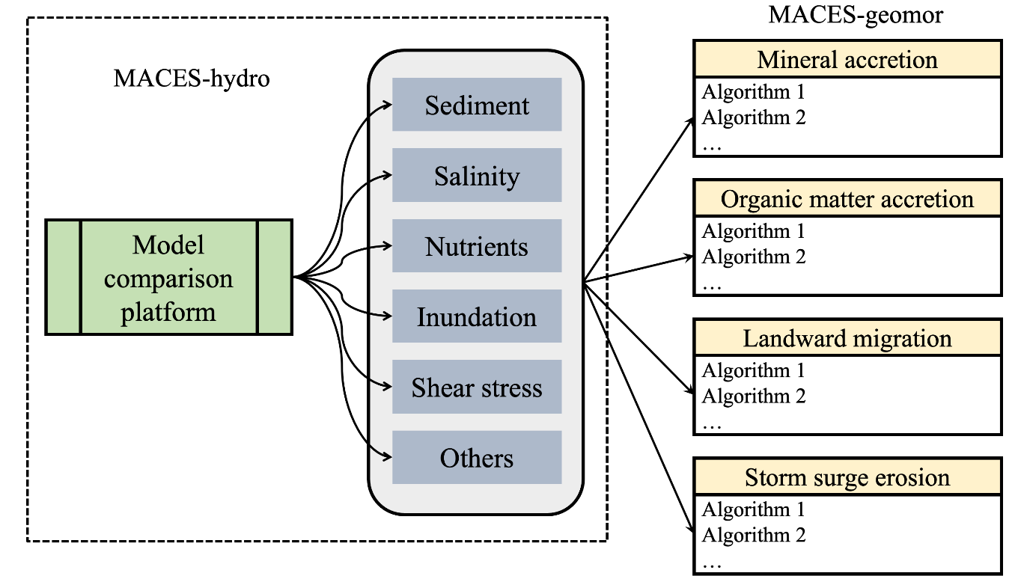
Understanding Resilience in Coastal Wetlands Using a Multi-Method Model
Objective
Develop a multi-algorithm model framework based on a unified hydrodynamics model to explore the most effective ways of simulating coastal wetland eco-geomorphology in Earth system models, reduce model uncertainties, and ultimately predict the fate of coastal wetlands under climate change at large scales.
Approach
A one-dimensional transect-based hydrodynamic model that can simulate water level, tide, wave, and suspended sediment was developed.
Multiple widely used algorithms of eco-geomorphological processes (i.e., mineral and organic matter accretion) were implemented in the model framework, known as the multi-algorithm coastal wetland eco-geomorphology simulator (MACES) model.
The multi-algorithm approach was tested in three representative coastal wetland sites to characterize structural uncertainties in the model.
Impact
The new approach is better than the traditional single-algorithm approach at predicting how eco-geomorphological processes change over space in both salt marshes and mangroves.
Model uncertainty can be reduced by incorporating observations of eco-geomorphology at different elevations and across diverse coastal wetland sites.
This study provides the coastal modeling community with a new tool, called MACES, to constrain the predicted evolution of coastal wetlands under climate change.
Tan, Z., Leung, L. R., Liao, C., Carniello, L., Rodríguez, J. F., Saco, P. M., & Sandi, S. G. A. Multi-algorithm approach for modeling coastal wetland eco-geomorphology. Frontiers in Earth Science 12, 1421265 (2024). [DOI: 10.3389/feart.2024.1421265]

