Slide 1
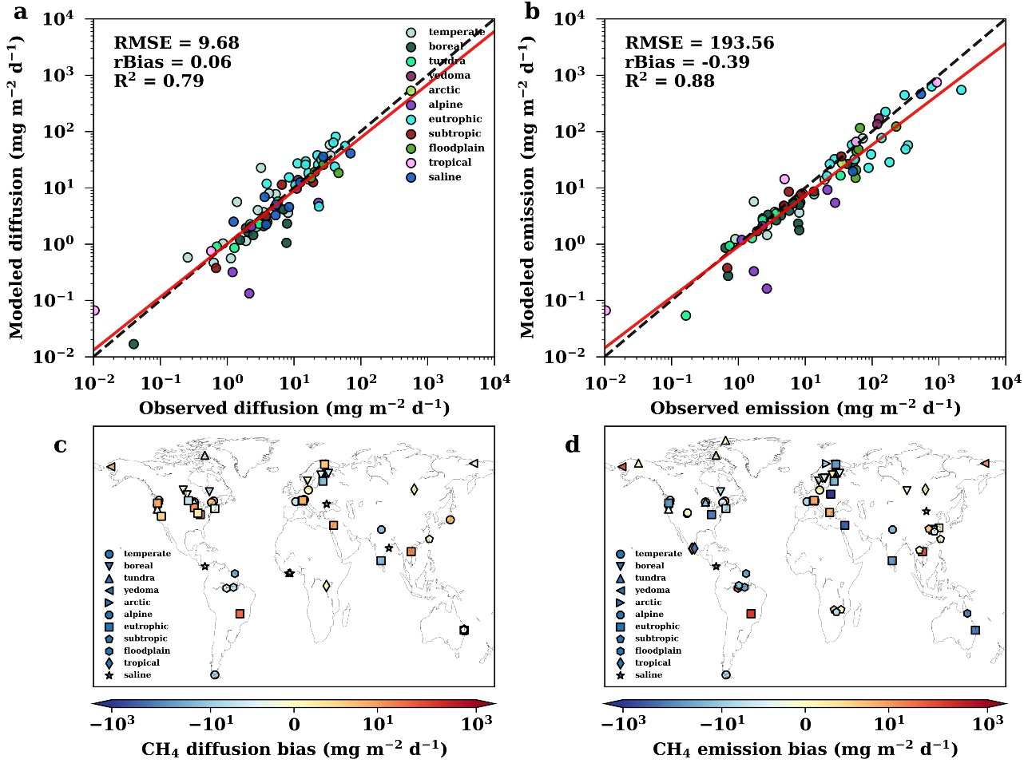
Improving the Representation of Methane Dynamics in Global Lake Models
Objective
Develop a lake methane (CH₄) model that can be integrated into Earth system models (ESMs) to predict global lake CH₄ emissions and constrain climate-CH₄ feedback.
Approach
Improve the Advanced Lake Biogeochemistry Model (ALBM) by representing lake bathymetry, oxic CH₄ production (OMP), and the effect of water level on ebullition, including new non-linear CH₄ oxidation kinetics, and coupling lake sediment carbon with in-lake primary production and terrigenous carbon loading.
Create a global lake CH₄ dataset that includes CH₄ emissions from 106 lakes for model validation.
Impact
The model shows promising performance in capturing the spatial and temporal variability of observed CH₄ emissions in the dataset, demonstrating the readiness of ALBM to be integrated into ESMs.
The results suggest that OMP, a newly discovered CH₄ production pathway, could play an important role in surface CH₄ diffusion.
The study also highlights the importance of including the impact of water level on CH₄ ebullition and using a new CH₄ oxidation scheme in lake CH₄ models.
The improved ALBM shows excellent performance in simulating the total CH₄ emission (a) and CH₄ diffusion (b) of the 106 lakes in the validation dataset, with moderate model biases (c, d).
Tan, Z., H. Yao, J. Melack, H.-P. Grossart, J. Jansen, S. Balathandayuthabani, et al. 2024. “A lake biogeochemistry model for global methane emissions: Model development, site-level validation, and global applicability.” J. Adv. Model. Earth Syst. 16, e2024MS004275. https://doi.org/10.1029/2024MS004275

