Slide 1
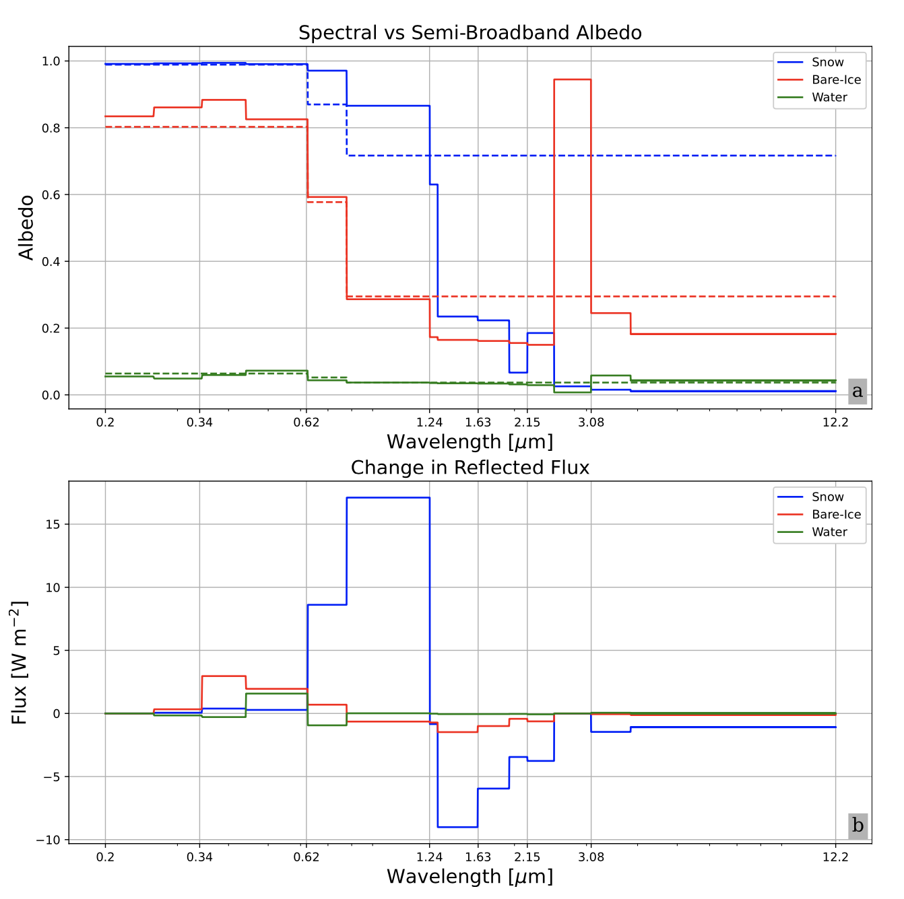
Surface and Atmospheric Heating Responses to a Spectral Surface Albedo
Scientific Challenge
ESMs exchange only VIS + NIR solar fluxes between surface ↔ atmosphere
What biases does this two-band approximation cause relative to exchanging fully spectrally resolved (14-band) solar flux?
Approach and Findings
Offline study with same radiation model (RRTMG) as E3SM, CESM
Two-band approx. artificially warms clear sky surface + lower atmosphere (a destabilizing effect)
Spectrally resolved albedo reduces warming most significantly over snow-covered surfaces (negligible effect over ocean)
Up to 1% warming reductions in clear sky, 10% in cloudy skies
Figure
Significance and Impact
Spectrally resolved surface albedo cools surface and atmosphere over snow and ice surfaces
Potential for significant bias reduction in polar regions of E3SM
Figure 1. (a) Spectral (solid) and semi‐broadband (dashed) albedo (direct radiation) for fresh snow, bare‐ice, and liquid water surfaces input into shortwave radiative transfer model. (b) Change in upwelling flux reflected by the surface. Wavelength scale is logarithmic.
Citation: Tolento, J. P., Zender, C. S., & Whicker-Clarke, C. A. (2024). Surface and atmospheric heating responses to spectrally resolved albedo of frozen and liquid water surfaces. Journal of Geophysical Research: Atmospheres, 129, e2023JD039824. https://doi.org/10.1029/2023JD039824
Department of Energy • Office of Science • Biological and Environmental Research
Notes:
Word highlight text here.

