Slide 1
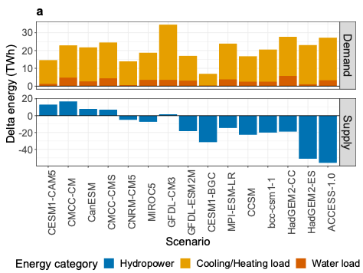
Climate change and its influence on water systems increases the cost of electricity system decarbonization
Scientific Challenge
Evaluate climate change impacts on the Western water system and resulting effects on infrastructure planning of the Western Interconnection grid.
a
Approach and Findings
Quantify changes in electricity demand for cooling/heating and for water, and hydropower generation under 15 climate future scenarios out to 2050.
Optimize generation and transmission by 2050 with grid capacity expansion model under the climate scenarios
By 2050 electricity demand increases under all climate scenarios and hydropower generation decreases under the majority of climate scenarios
b
Figure
Significance and Impact
To adapt to these climate impacts, the region could need to build up to 139 GW (+14%) more generating capacity, about 3x California’s current peak demand.
Baseline Scenario and cumulative change in Western Interconnection generation capacity built in 2030 – 2050 for climate scenarios. Black points indicate the total net change in generating capacity across all energy sources under each climate scenario relative to the Baseline Scenario.
a) 2050 changes in electricity supply and demand under climate scenarios compared to Baseline Scenario with historical climate. (b) Baseline Scenario and 2030 – 2050 change in generation capacity for climate scenarios. Points indicate total net change across all energy sources.
Szinai, Julia K., David Yates, Pedro A. Sánchez-Pérez, Martin Staadecker, Daniel M. Kammen, Andrew D. Jones, and Patricia Hidalgo-Gonzalez. “Climate Change and Its Influence on Water Systems Increases the Cost of Electricity System Decarbonization.” Nature Communications 15, 10050 (2024) [DOI: 10.1038/s41467-024-54162-9].
Department of Energy • Office of Science • Biological and Environmental Research
Notes:
Word highlight text here.

