Slide 1
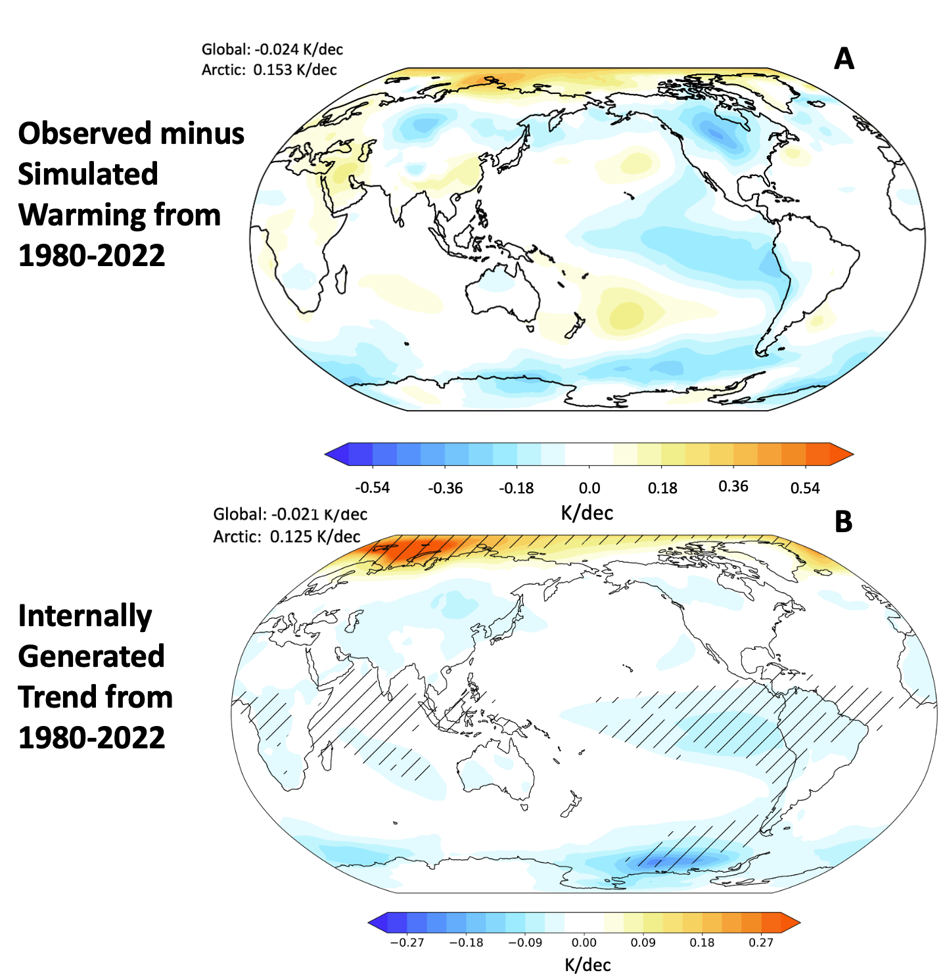
Fingerprinting the Pattern of Internal Variability in Recent Global Warming
Objective
Our previous work demonstrated that internal variability has enhanced Arctic surface warming and suppressed global surface warming over 1980-2022, leading to high values of Arctic Amplification, and such internally generated global cooling and Arctic warming is termed as i-GCAW.
Here we aim to understand the i-GCAW pattern and show whether and how climate models reproduce it.
Approach
Composite model simulations that exhibit i-GCAW, test for pattern robustness, and examine how surface temperatures evolve after an instance of i-GCAW.
Impact
The i-GCAW pattern is rare but robust in models, featuring enhanced warming in the Arctic Barents and Kara Sea and cooling in the Tropical East Pacific and Southern Ocean.
i-GCAW is imprinted on observations, showing the importance of internal variability in explaining model-observational differences.
Comparisons of A)
observed warming minus multi-model mean simulated warming (scaled by forced global mean trend based on observations) and B) the model generated internal trend pattern associated with i-GCAW. Hatching shows where over 80% of the ensemble members agree in sign. The pattern in A matches the i-GCAW pattern in B, indicating that internal variability strongly contributes to differences between models and observations.
Sweeney, A. J., Fu, Q., Po-Chedley, S., Wang, H., & Wang, M. (2024). Unique temperature trend pattern associated with internally driven global cooling and Arctic warming during 1980–2022. Geophysical Research Letters, 51, e2024GL108798. https://doi.org/10.1029/2024GL108798

