Slide 1
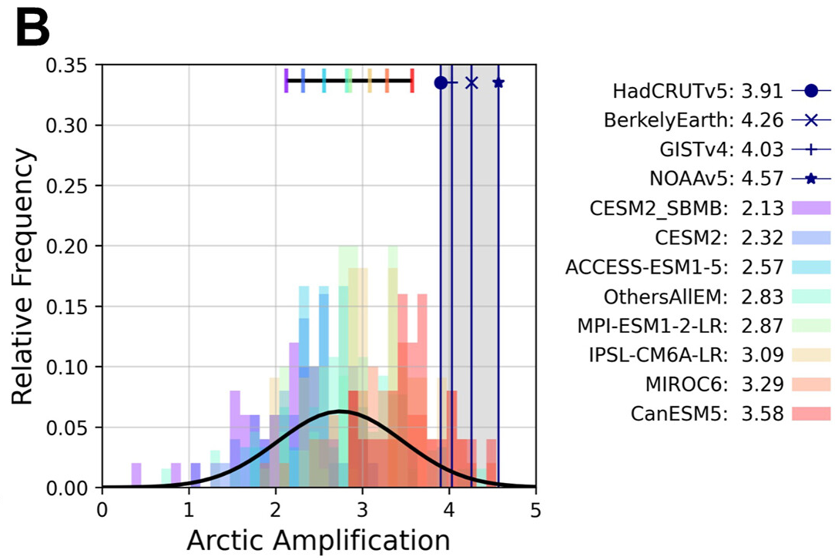
Internal Variability Amps Up Arctic Warming
Objective
Quantify contributions of internal variability to historical Arctic and global warming since 1980 and reconcile the discrepancy between observed and model simulated Arctic amplification (AA).
Approach
Use climate model data to train a machine learning (ML) algorithm to quantify the contribution of internal variability to Arctic and global surface air temperature trends (1980-2022).
Apply the ML algorithm to observations and partition internally generated and externally forced temperature trends over the Arctic and globe.
Impact
The ML algorithm is effective at disentangling internally generated variability and externally forced changes in AA.
Internal climate variability has enhanced AA over the past four decades (1980-2022).
After accounting for internal climate variability, climate models and observations show excellent agreement in AA.
Observed AA
Observed AA
with IV removed
IV impact
Comparisons of AA in observations (vertical lines) and models (color bars; black curve showing a normal distribution fit) with values shown in the legend. The brown box marks the observed AA after internal variability (IV) is removed. After removing the IV, observations and climate models show excellent agreement in AA, suggesting that IV increased AA by 38% during 1980-2022.
Sweeney, A. J., Fu, Q., Po-Chedley, S., Wang, H., & Wang, M. “Internal variability increased Arctic amplification during 1980–2022.” Geophysical Research Letters, 50, e2023GL106060 (2023). [DOI: 10.1029/2023GL106060]

