Slide 1
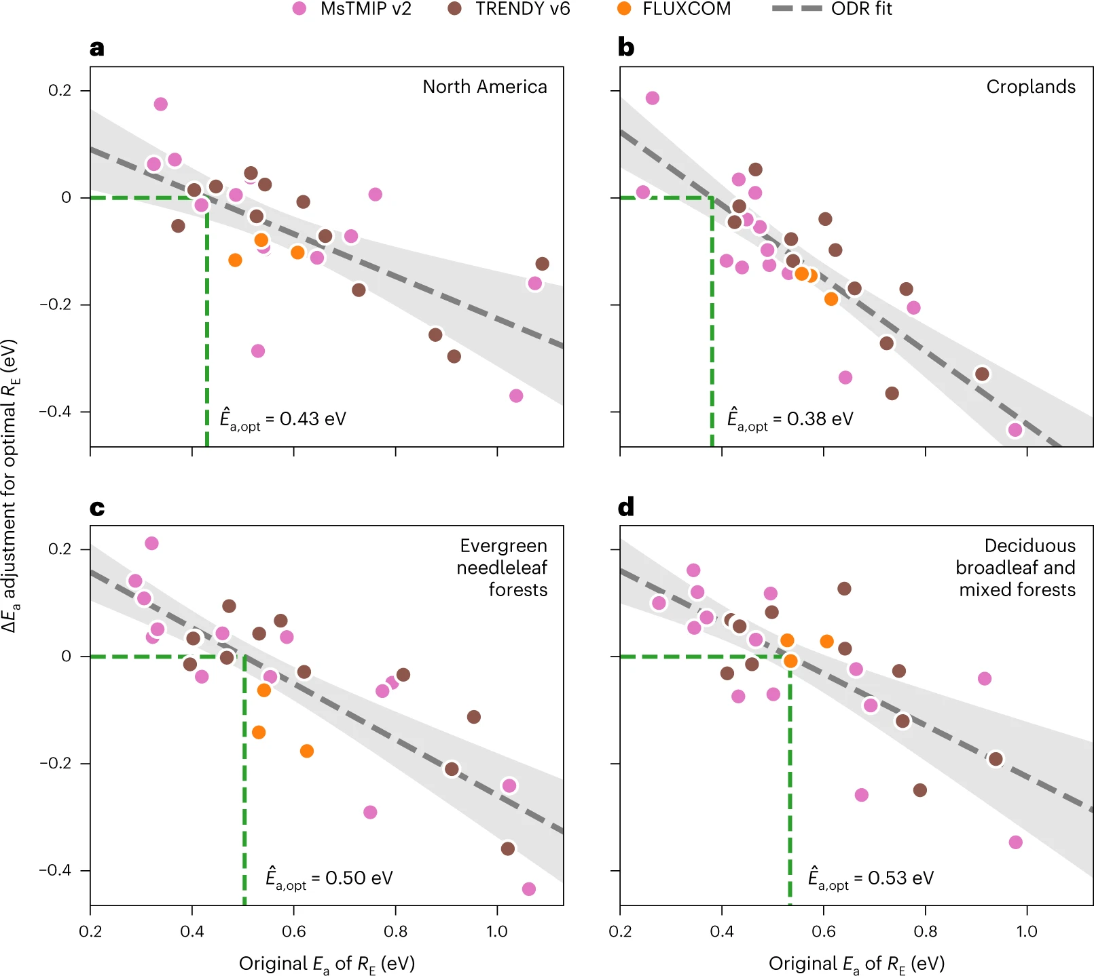

Biome-scale temperature sensitivity of ecosystem respiration revealed by atmospheric CO2 observations
Scientific Achievement
Fig. Relationships between adjustments to model-specific estimates of the activation energy needed to maximize consistency with observed atmospheric CO2 variability and the original estimates of activation energy for models in the MsTMIP v2 (pink), TRENDY v6 (brown) and FLUXCOM (orange) model ensembles
In this study we use observations of atmospheric CO2 concentrations from a network of towers together with carbon flux estimates from state-of-the-art terrestrial biosphere models to characterize the temperature sensitivity of ecosystem respiration, as represented by the Arrhenius activation energy, over various North American biomes.
Significance and Impact
We infer activation energies for major biomes, which are substantially below those reported for plot-scale studies. This discrepancy suggests that sparse plot-scale observations do not capture the spatial-scale dependence and biome specificity of the temperature sensitivity. We further show that adjusting the apparent temperature sensitivity in model estimates markedly improves their ability to represent observed atmospheric CO2 variability.
Research Details
We use observations of atmospheric CO2 concentrations together with carbon flux estimates from terrestrial biosphere models to characterize the temperature sensitivity of ecosystem respiration, as represented by the Arrhenius activation energy, over various North American biomes.
Sun W et al. (2023), Nature Ecology and Evolution
DOI: https://doi.org/10.1038/s41559-023-02093-x

