Slide 1
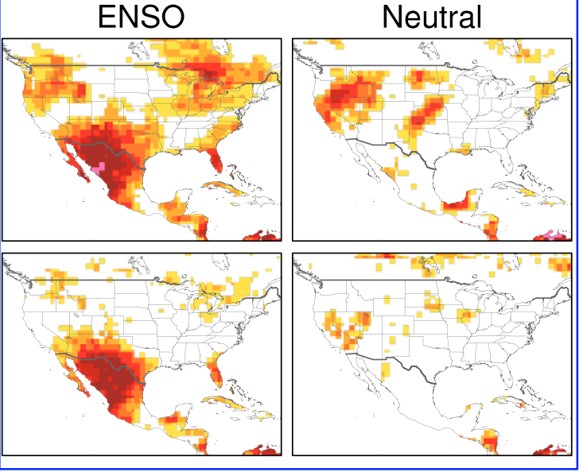
Attribution of North American Subseasonal Precipitation Prediction Skill
L. Sun, M. P. Hoerling, J.H. Richter, A. Hoell, A. Kumar (20222): Weather & Forecasting: DOI: 10.1175/WAF-D-22-0076.1
OBJECTIVE
To understand the seasonal and regional variations of the North American subseasonal (weeks 3 – 6) precipitation skill.
APPROACH
We utilized five subseasonal reforecast datasets (ECMWF-IFS, NCEP-CFSv2, NCEP-GEFSv12, CESM1, CESM2) as well as uninitialized simulations with atmospheric components of 4 of the models (ECMWF-IFS, NCEP-CFSv2, CESM1, CESM2). We evaluate precipitation skill over North America utilizing the anomaly correlation coefficient (ACC).
Reforecasts
IMPACT
Subseasonal prediction of precipitation is one of the current grand challenges. Over the United States, NOAA’s official U.S. monthly precipitation forecast skill has been historically low. We compare skill arising from initial atmospheric states to that arising from ocean surface boundary states alone. We find that precipitation skill for weeks 5-6 has similar amplitude and variability to that derived from AMIP simulations. We also find that ENSO is the main source of subseasonal precipitation skill over Southwest of the United States and Central America, as well as Florida but only in DJF.
AMIP
Monthly precipitation skill in DJF over ENSO and ENSO-neutral states in Reforecasts (top) and AMIP simulations (bottom)

