Slide 1
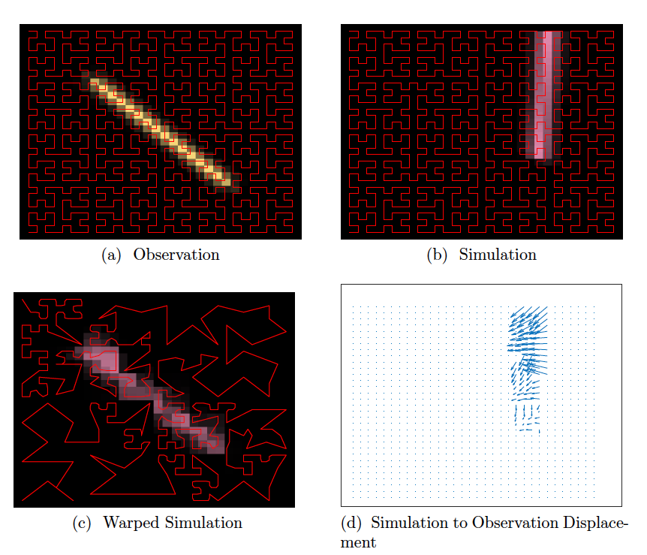
CIEL*Ch Color Map for Visualization and Analysis of Sea Ice Motion
Scientific Challenge
Fractures (leads) can be represented by two-dimensional vector fields.
Direct comparison between fracture patterns is flawed since fractures may be misaligned or misshapen between observations and a simulation.
New metrics are needed to measure differences in fracture patterns.
Approach and Findings
Propose a color map for two-dimensional vectors. The L2 norm on color codes induces a metric on vectors so that differences in vector fields can be analyzed and visualized through differences in color.
Color-coded fracture patterns are optimally aligned using a diffeomorphism. The size of the diffeomorphism (phase error) and the difference between images after optimal alignment (amplitude error) are metrics.
Space-filling curves are used to sample a 2D image and convert the 2D image to a 1D function. Functional alignment is numerically easier and reliable using dynamic programming.
Significance and Impact
Images with idealized fractures demonstrate that image alignment is possible and accurate using space filling curves.
New image-based metrics quantify differences between fracture patterns and show promise in parameter calibration.
New visualization tool is used to compare Arctic sea-ice motion patterns and can be applied to other vector fields.
Color-coded idealized single crack (a,b). A space filling curve samples the images. (c) Warped space filling curve that aligns the simulation to the observation and aligns the crack. (d) Motion necessary to align images.
J. Upston, D. Sulsky, J.D. Tucker, Y. Guan. CIEL∗Ch color map for visualization and analysis of sea ice motion. Journal of Computational and Applied Mathematics, 429:115-126, 2023.
Department of Energy • Office of Science • Biological and Environmental Research
Notes:
15 Oct 2023
CIEL*Ch Color Map for Visualization and Analysis of Sea Ice Motion
A color map for 2D vector fields provides new metrics to analyze ice motion and localized sea ice fractures.
The Science
Comparisons between images of modeled and observed ice fractures provide a way to evaluate the performance of a sea ice model. However, direct comparison between patterns of fracture based on point-wise differences is flawed since fractures may be misaligned or misshapen between observations and a simulation. This motivates the need for new metrics to quantify the difference between images of fracture patterns.
The Impact
We compare color-coded fracture patterns using new metrics based on image warping where warping aligns misaligned or misshapen features. The warping is done reliably and accurately using space filling curves to sample the images. A new image-based amplitude metric and a phase distance measure are provided to quantify differences between fracture patterns and these show promise as tools in parameter calibration.
Summary
We propose a color map for vectors based on use of the Lightness-Chroma-hue (L*Ch) color space defined by the International Commission on Illumination (CIE). This color space is designed to be perceptually uniform so that a given numerical change in the color code corresponds to a given perceived change in color. Within the color space, vector magnitude is mapped to the intensity of the color while hue (a periodic quantity) indicates the vector direction (also periodic). Additional information about the vector field can be encoded in the color map by varying the chroma. The L2 norm on the color codes induces a metric on vectors, allowing us to analyze and visualize the differences in vectors through differences in color.
We compare fracture patterns utilizing the colormap and image warping. Firstly, the fractures, described by a vector jump in displacement, are visualized using the CIEL*Ch color map. We then use space filling curves to convert the color-mapped 2D image to 1D function and perform functional warping to rectify the misalignment between images. The conversion to a function provides a simpler and more reliable numerical solution compared to image warping which is computationally challenging. After optimally aligning images, two measures are defined, (1) the amount of warping needed to align the images and (2) an L2 distance after alignment. These measures quantify the differences between fracture patterns and can be visualized naturally through the color map. We demonstrate the usefulness of the new tools in comparing vector fields from Arctic sea-ice motion data in January 1994 and January 1995, and the potential of applying our new measures in model calibration in a multi-crack experiment.
Contacts (BER PM)
Xujing Davis
Earth System Model Development E-Mail: xujing.davis@science.doe.gov
(PI Contact)
Deborah Sulsky University of New Mexico E-Mail: sulsky@math.unm.edu
Funding
This study was supported by the Department of Energy (DOE), Office of Science, the Scientific Discovery through Advanced Computing (SciDAC) program, under a partnership in Earth System Model Development between the Biological and Environmental Research (BER) and the Advanced Scientific Computing Research (ASCR) under Award Number DE-SC0023366.
Publications
J. Upston, D. Sulsky, J.D. Tucker, Y. Guan. CIEL∗Ch color map for visualization and analysis of sea ice motion. Journal of Computational and Applied Mathematics, 429:115-126, 2023.
Related Links
Publication: https://doi.org/10.1016/j.cam.2023.115126
Project: https://mpas-si-mpm.unm.edu/description.html

