Slide 1
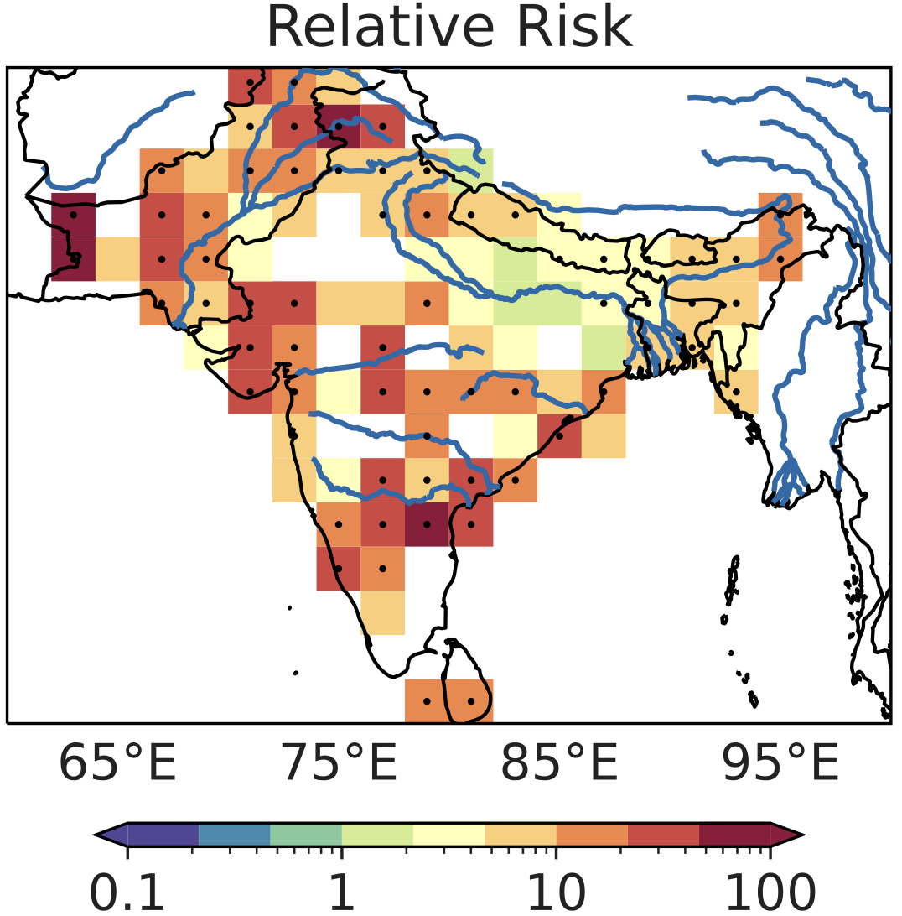
Monsoon low pressure systems and hydrometeorological disasters
Scientific Challenge
Transient atmospheric vortices called monsoon low pressure systems produce extreme rainfall, but the number of human mass-casualty disasters caused by these storms remained unknown.
Approach and Findings
Researchers geolocated each event in a large dataset of human mass-casualty disasters, and associated it with a multi-decadal storm track dataset; they found that monsoon low pressure systems produce more than half of hydrometeorological disasters in South Asia during summer.
Figure
Significance and Impact
The study found a sharp peak in rainfall on the day of disasters, confirming the physical link between monsoon low pressure systems and these hydro-meteorological disasters. A similar peak in rainfall was found in weather forecasts made up to five days before the disaster, suggesting that short-term precipitation forecasts can be useful in disaster preparation.
Relative risk of disasters due to the presence of LPS (values >1 indicate that risk of disaster occurrence is increased due to the presence of a low pressure system).
Suhas, D.L., Ramesh, N., Kripa, R.M. and Boos, W.R., 2023. Influence of monsoon low pressure systems on South Asian disasters and implications for disaster prediction. npj Climate and Atmospheric Science, 6, p.48, https://doi.org/10.1038/s41612-023-00376-5.
Department of Energy • Office of Science • Biological and Environmental Research
Notes:
Word highlight text here.

