Slide 1
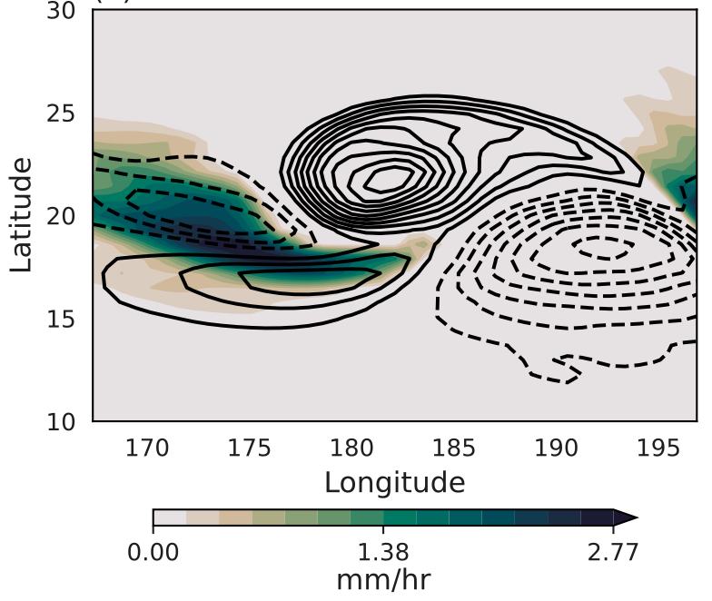
Understanding controls on monsoon depression intensity
Scientific Challenge
Understand the physical processes responsible for the intensification of monsoon depressions, which are a weather system that produces extreme rainfall in highly populated parts of the tropoics.
Approach and Findings
An idealized moist shallow-water model with parameterized precipitation is used to examine the relative role played by two environmental gradients, in moisture and in zonal wind, in the intensification of initial disturbances.
Figure
Significance and Impact
Results show that environmental gradients in eastward wind speed and humidity can both contribute to the amplification of monsoon depressions.
The intensification rates of wind and precipitation exhibited different sensitivities to the environmental gradients, yielding novel guidance on the response of these storms to environmental changes.
Vorticity (black contours) and precipitation rate (shading) in a shallow-water simulation of a monsoon depression.
D. L. Suhas and William R. Boos (2023). Monsoon Depression Amplification by Horizontal Shear and Humidity Gradients: A Shallow Water Perspective. Journal of the Atmospheric Sciences, 80, pp.633-647, doi:10.1175/JAS-D-22-0146.1
Department of Energy • Office of Science • Biological and Environmental Research
Notes:
Word highlight text here.

