Slide 1
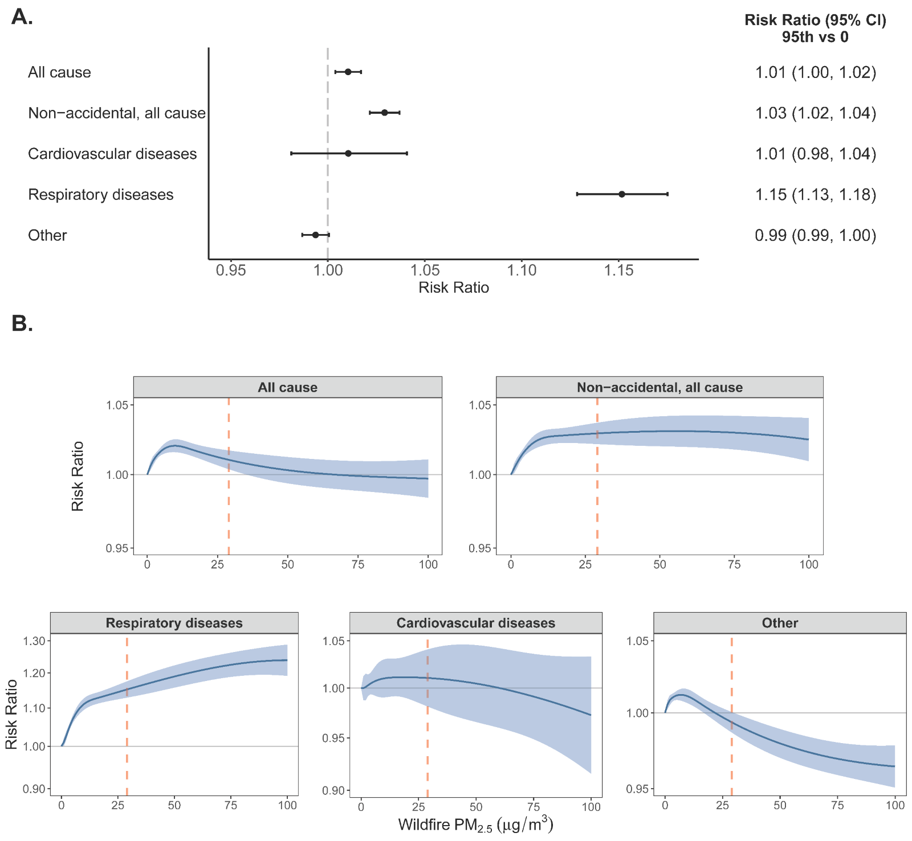
Emergency Department Visits in California Associated with Wildfire PM_{2.5}
Objective
Health impacts from wildfire smoke in are increasing, especially in the Western US. We investigate how exposure to fine particulates (PM_{2.5}) from wildfire smoke affects emergency department (ED) visits in California and assess how these health risks vary across different population subgroups and community characteristics. By examining factors such as age, race, air conditioning prevalence, and social vulnerability, we identify disparities in health outcomes and inform strategies to protect vulnerable populations.
Approach
We conduct an empirical analysis, using data on over 48 million ED visits linked to daily wildfire-specific PM_{2.5} concentrations in California for 2012-2019, employing a time-stratified case-crossover design with distributed lag non-linear modeling to estimate individuals’ hospitalization risk associated with wildfire smoke exposure. Stratifying our model by population and community characteristics reveals differential health risks.
Impact
Wildfire PM_{2.5} exposure was associated with increased risk of ED visits for all causes, non-accidental causes, and, most strongly, respiratory diseases. Risk varied systematically across population subgroups, with children under 10 and adults over 20 showing higher risks, Black populations experiencing the highest relative risk, and areas with lower air conditioning prevalence exhibiting greater vulnerability. By highlighting the public health risks associated with wildfire smoke exposure, and how these impacts differ based on measures of vulnerability and adaptation, we provide essential insights for developing targeted interventions and policies to protect vulnerable populations and communities.
Impact of wildfire PM_{2.5} exposure on ED visits in California, 2012-2019. A. Risk ratios and 95% confidence intervals of the associations between PM_{2.5} and ED visits comparing the 95th percentile of lag 0-7 exposure to no exposure. B. Exposure-response curves for the associations between exposure to PM_{2.5} and ED visits (dashed line: 95th percentile).
Stowell, JD, Sue Wing I, Romitti Y, Kinney PL, Wellenius GA (2024). Emergency department visits in California associated with wildfire PM_{2.5}: differing risk across individuals and communities, Environmental Research: Health forthcoming. https://doi.org/10.1088/2752-5309/ad976d

