Slide 1
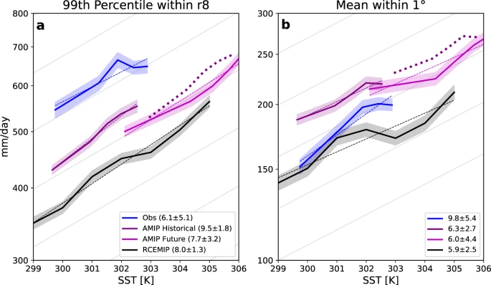
Global tropical cyclone precipitation scaling with sea surface temperature
Objective
Understand the relationship between tropical cyclone (TC) precipitation and sea surface temperature (SST) on two different time scales:
  1) the short-term present-day variability between TC precipitation and SST (i.e., the apparent scaling)
  2) the long-term change in TC precipitation as SST warms due to climate change (i.e., the climate scaling)
Approach
Compare TCs and their precipitation in idealized rotating RCEMIP simulations, AMIP-type CAM5 simulations, and observations
Impact
The apparent scaling of TC precipitation with SST in observations and models is greater than the climate scaling estimated from the model simulations. This implies that the apparent scaling should not be used to project how TC precipitation will be impacted by climate change.
Scaling rate estimates can depend on methodology choices (e.g., precipitation metric, averaging radius around TC center, etc…) and therefore future studies should use multiple precipitation metrics in their analysis.
Relationship between TC precipitation and SST for (a) 99th percentile of 6-hourly TC precipitation rates within r8 and (b) mean of 6-hourly TC precipitation rates within 1° of the TC center, binned by SST, for observations (blue), AMIP Historical (purple), AMIP Future (pink), and RCEMIP (black). Values are binned into 5 SST bins that each have approximately the same number of samples. The thin dashed colored lines show the exponential regression fit. The light gray lines in the background show the C-C rate. The thick dotted purple line shows the AMIP Historical line multiplied by 0.07 and by the difference in global mean SST between AMIP Historical and AMIP Future (3.3 K). The shaded regions behind the lines show the 95% confidence intervals, calculated using bootstrapping with 10,000 repetitions with replacement. Numbers in the legends are the apparent scaling of the precipitation metric, shown with 95% confidence intervals estimated using a student’s t-distribution.
Stansfield, A.M., Reed, K.A. Global tropical cyclone precipitation scaling with sea surface temperature. npj Clim Atmos Sci 6, 60 (2023). https://doi.org/10.1038/s41612-023-00391-6

