Slide 1
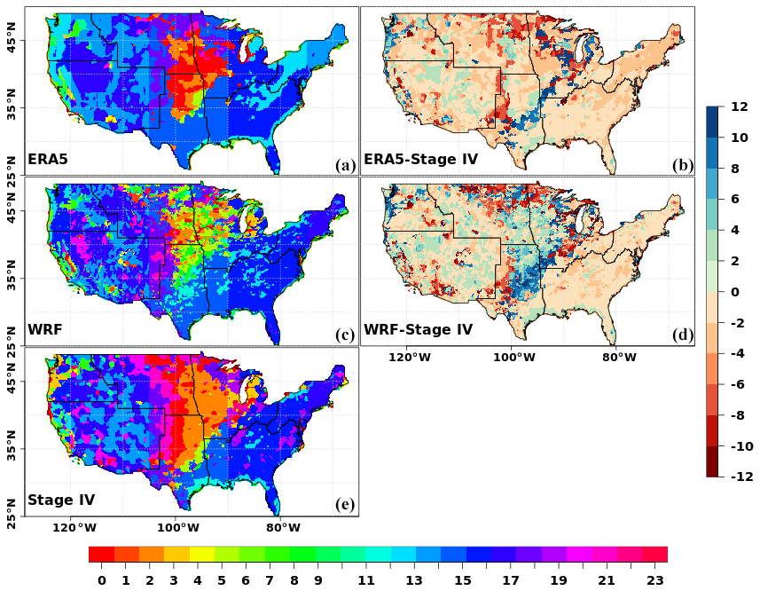
Assessment of WRF (v 4.2.1) dynamically downscaled precipitation on subdaily and daily timescales over CONUS
Objective
Analyze the simulated historical precipitation across the contiguous United States (CONUS) in a 12 km Weather Research and Forecasting model version 4.2.1 (WRF v 4.2.1)-based dynamical downscaling of the fifth-generation ECMWF atmospheric reanalysis (ERA5).
Approach
Comprehensive evaluation of 3- and 24-hr precipitation characteristics (diurnal and annual cycles, annual and seasonal means, precipitation frequency and their probability distribution) across regions and seasons over the contiguous United States. Such evaluation is necessitated by the fact that the dominant precipitation processes depend upon timescale, season, and regions.
Impact
WRF well simulates the timing and magnitude of the summer precipitation diurnal cycle and the precipitation annual cycle.
The biases in the 12-km WRF are comparable to the convection-permitting WRF simulations.
WRF exhibits seasonally dependent precipitation biases across the CONUS.
Although dynamical downscaling improves the fine-resolution representation of precipitation, it still needs reasonable bias correction before being used as input data for domain-specific models.
Timing of the diurnal precipitation peak (TDPP) in JJA (in units of hours at local solar time) estimated over 2003–2019. Panels (a), (c), and (e) show the timing in each dataset and use the color scale along the bottom edge of the figure. Panels (b) and (d) show differences in timings of the precipitation peak and use the color scale along the right edge of the figure.
Srivastava, A. K., Ullrich, P. A., Rastogi, D., Vahmani, P., Jones, A., and Grotjahn, R.: Assessment of WRF (v 4.2.1) dynamically downscaled precipitation on subdaily and daily timescales over CONUS, Geosci. Model Dev., 16, 3699–3722, https://doi.org/10.5194/gmd-16-3699-2023, 2023.

