Slide 1
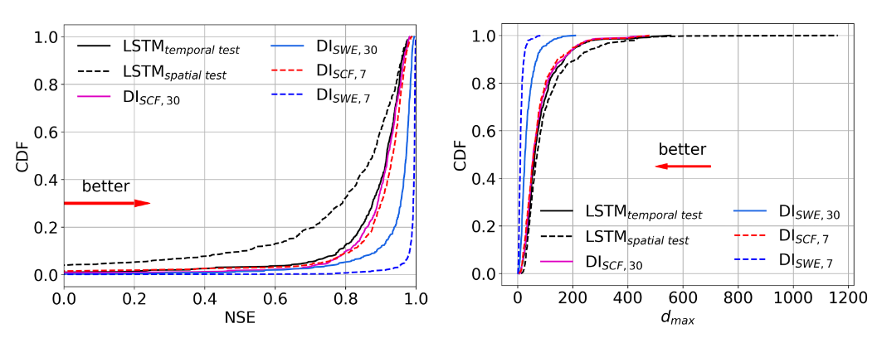
LSTM-based data integration to improve snow water equivalent prediction and diagnose error sources
Objectives
Determine how much improvement in SWE prediction can be obtained by integrating SWE observations with 30-day or 7-day lag times
Test usefulness of recent observations of SWE and SCF data for sites without in situ data (unmonitored sites)
Find the orders of magnitude of predictive errors for SWE, their characteristics, and which locations are most susceptible to these errors
Conclusions
An LSTM deep learning model was able to predict snow water equivalent across the western United States. Integrating satellite-sourced snow cover fraction observations was mainly helpful for shallow-snow sites during snowmelt, while site-based measurements of snow water equivalent improved prediction accuracy on shallow- and deep-snow sites.
The model developed in this work was highly competitive against previous snow models, and data integration further improved predictions. Such a model could serve as a useful forecasting tool for water resource managers in snow-dominated regions.
Empirical cumulative distribution function of test performance metrics: (left) Nash-Sutcliffe Efficiency (NSE) and (right) d_{max} (difference between estimated and observed peak values) for the forward and DI models. LSTM_{temporal_test} (black solid line) denotes the forward model in the temporal test; LSTM_{spatial_test} (black dashed line) denotes the forward model in the spatial test (prediction at untrained sites). The remaining model results are for the temporal test: DI_{SCF,30} (pink solid line) integrates 30-day-lagged snow cover fraction (SCF) observations; DI_{SWE,30} (blue solid line) integrates 30-day-lagged snow water equivalent (SWE) observations; DI_{SCF,7} (red dashed line) integrates 7-day-lagged SCF observations; and DI_{SWE,7} (blue dashed line) integrates 7-day-lagged SWE observations. The red arrows marked “better” show the direction in which model improvement occurs.
Song, Y., Tsai, W.-P., Gluck, J., Rhoades, A., Zarzycki, C., McCrary, R., Lawson, K., & Shen, C. (2024). LSTM-based data integration to improve snow water equivalent prediction and diagnose error sources. Journal of Hydrometeorology, 25(1), 223–237. https://doi.org/10.1175/JHM-D-22-0220.1

