Slide 1
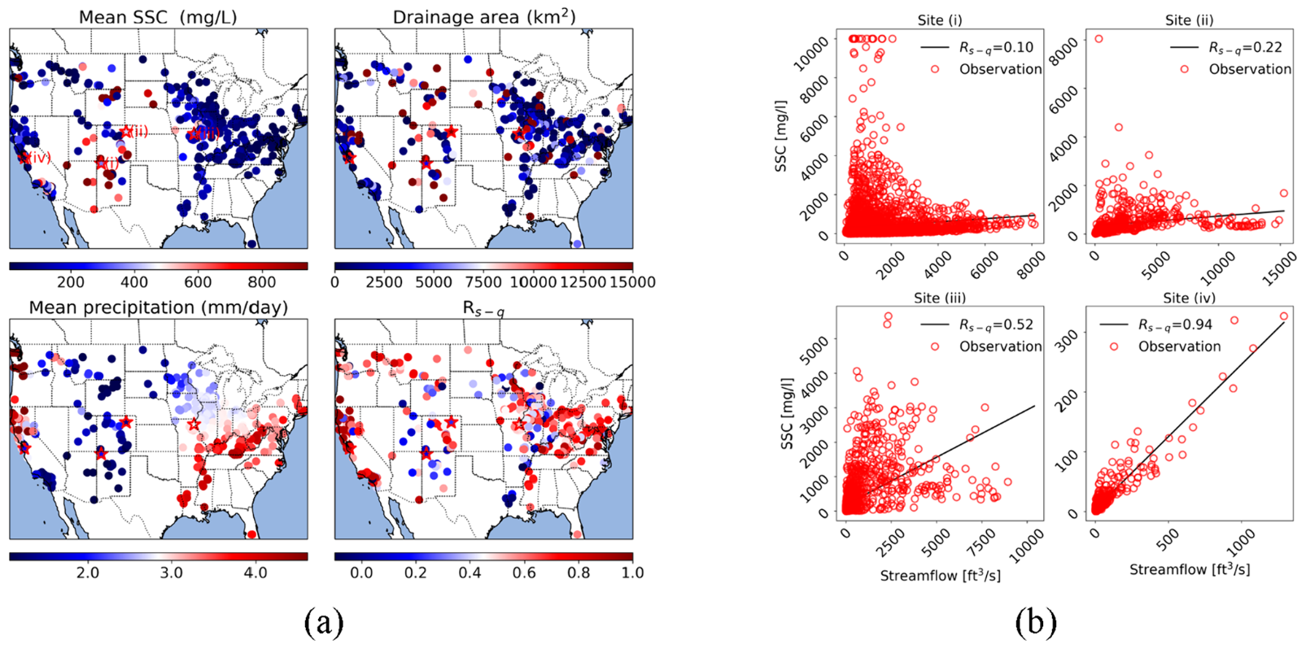
Deep learning insights into suspended sediment concentrations across the conterminous United States: Strengths and limitations
Objective
Train a deep learning model to predict daily streamflow suspended sediment concentration across the US, including unmonitored basins.
Impact
The WholeCONUS model compared well against individual basin models for predicting daily SSC, upholding the theory of data synergy (larger quantities of more diverse training data lead to better models compared to lower quantities of specifically localized/applicable training data). This may suggest that all local factors co-vary with the environment, and implies the existence of a generic, environment-dependent relationship that can be learned.
To our knowledge, this was the first attempt to build a continental-scale data-driven model for daily SSC, which allowed us to study the heterogeneity of SSC on a regional scale.
The Whole-CONUS model predict SSC well in unmonitored basins, which indicates that reasonably accurate predictions of SSC can be made with only meteorological forcings, static watershed attributes, and streamflow observations. Given that all of these are much more commonly-available datasets compared to suspended sediment concentration measurements, LSTM thus provides an alternative to traditional methods constrained to specific sites - a way to predict SSC in any CONUS basin with satisfactory accuracy.
(a) Maps of suspended sediment concentration (SSC) and its correlated variables: mean of observed SSC, drainage area, mean precipitation, and SSC-streamflow correlation (R_{s-q}); (b) Relationship between SSC and streamflow for selected sites marked by red stars in (a).
Song, Y., Chaemchuen, P., Rahmani, F., Zhi, W., Li, L., Liu, X., Boyer, E., Bindas, T., Lawson, K., & Shen, C. (2024). Deep learning insights into suspended sediment concentrations across the conterminous United States: Strengths and limitations. Journal of Hydrology, 639, 131573. https://doi.org/10.1016/j.jhydrol.2024.131573

