Slide 1
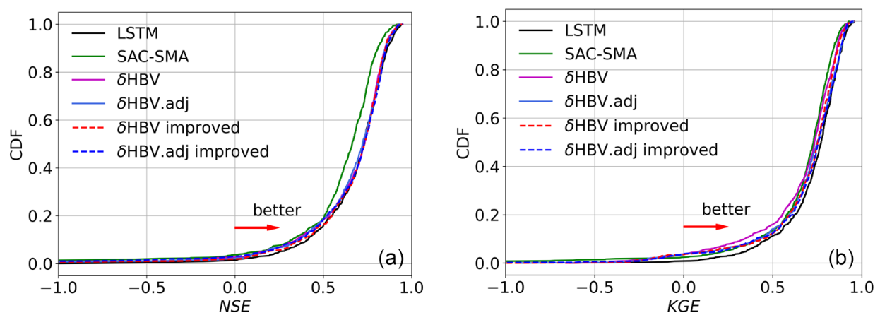
When ancient numerical demons meet physics-informed machine learning: adjoint-based gradients for implicit differentiable modeling
Objective
Enable complex implicit schemes to enrich differentiable modeling in hydrology
Approach
The “discretize-then-optimize” adjoint method was developed and applied to streamflow prediction across the US.
Impact
Adjoint model particularly improved low-flow, high-flow, and groundwater simulations, meaning flood peaks and droughts can be more accurately predicted.
Other hydrological problems that require implicit solutions can also benefit from this method, such as groundwater and shallow water equations.
Differentiable models can now outperform pure deep learning models in low-flow and high-flow metrics at the median, and thus:
physics-based restrictions (and physical interpretability) and state-of-the-art performance are not mutually exclusive
pure deep networks are not necessarily the performance ceiling of environmental models
for rarely observed events or spatial extrapolation, the addition of physical equations may potentially overcome data limitations
Empirical cumulative distribution function of the test performance metrics for all the models: Nash–Sutcliffe efficiency (NSE, a) and Kling–Gupta efficiency (KGE, b). LSTM represents a fully data-driven deep learning model previously used in Kratzert et al. (2019), and SAC-SMA is a purely process-based model for which the simulation results are provided in CAMELS. δHBV represents the original differentiable explicit “sequential” HBV model, and δHBV.adj is the implicit adjoint-based HBV model. “Improved” indicates models where a capillary flux was added from the lower subsurface zone to the surface soil to mitigate issues with zero and low flows.
Song, Y., Knoben, W. J. M., Clark, M. P., Feng, D., Lawson, K., Sawadekar, K., & Shen, C. (2024). When ancient numerical demons meet physics-informed machine learning: Adjoint-based gradients for implicit differentiable modeling. Hydrology and Earth System Sciences, 28(13), 3051–3077. https://doi.org/10.5194/hess-28-3051-2024

