Slide 1
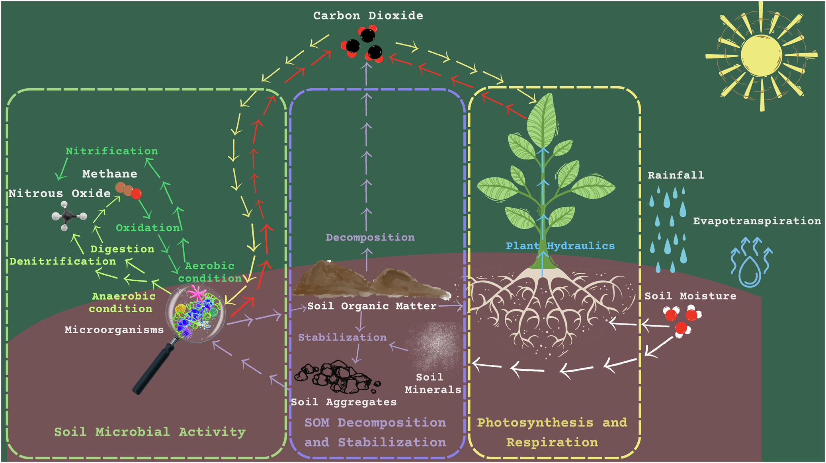
Soil Moisture Controls Over Carbon Sequestration and Greenhouse Gas Emissions: A Review
Objective: To review soil moisture's influence on carbon sequestration and greenhouse gas emissions across ecosystems.
Approach: Synthesize experimental data, model analyses, and sustainable practices to explore soil moisture impacts on CS-GHG dynamics.
Results/Impacts: Soil moisture regulates CS-GHG via photosynthesis, microbial activity, and organic matter dynamics. Optimal moisture enhances sequestration, while extremes disrupt processes. Management practices like conservation agriculture and agroforestry mitigate GHGs. Hybrid modeling and policy shifts towards long-term goals are critical for sustainable land management and environmental benefits.
Figure: Conceptual diagram: the role of soil moisture in carbon sequestration and greenhouse gas emissions.
Hao, Yuefeng, Jiafu Mao, Charles M. Bachmann, Forrest M. Hoffman, Gerbrand Koren, Haishan Chen, Hanqin Tian, Jiangong Liu, Jing Tao, Jinyun Tang, Lingcheng Li, Laibao Liu, Martha Apple, Mingjie Shi, Mingzhou Jin, Qing Zhu, Steve Kannenberg, Xiaoying Shi, Xi Zhang, Yaoping Wang, Yilin Fang, and Yongjiu Dai. "Soil Moisture Controls Over Carbon Sequestration and Greenhouse Gas Emissions: A Review." npj Climate and Atmospheric Science 8, Article 16 (2025). https://doi.org/10.1038/s41612-024-00888-8.

