Slide 1
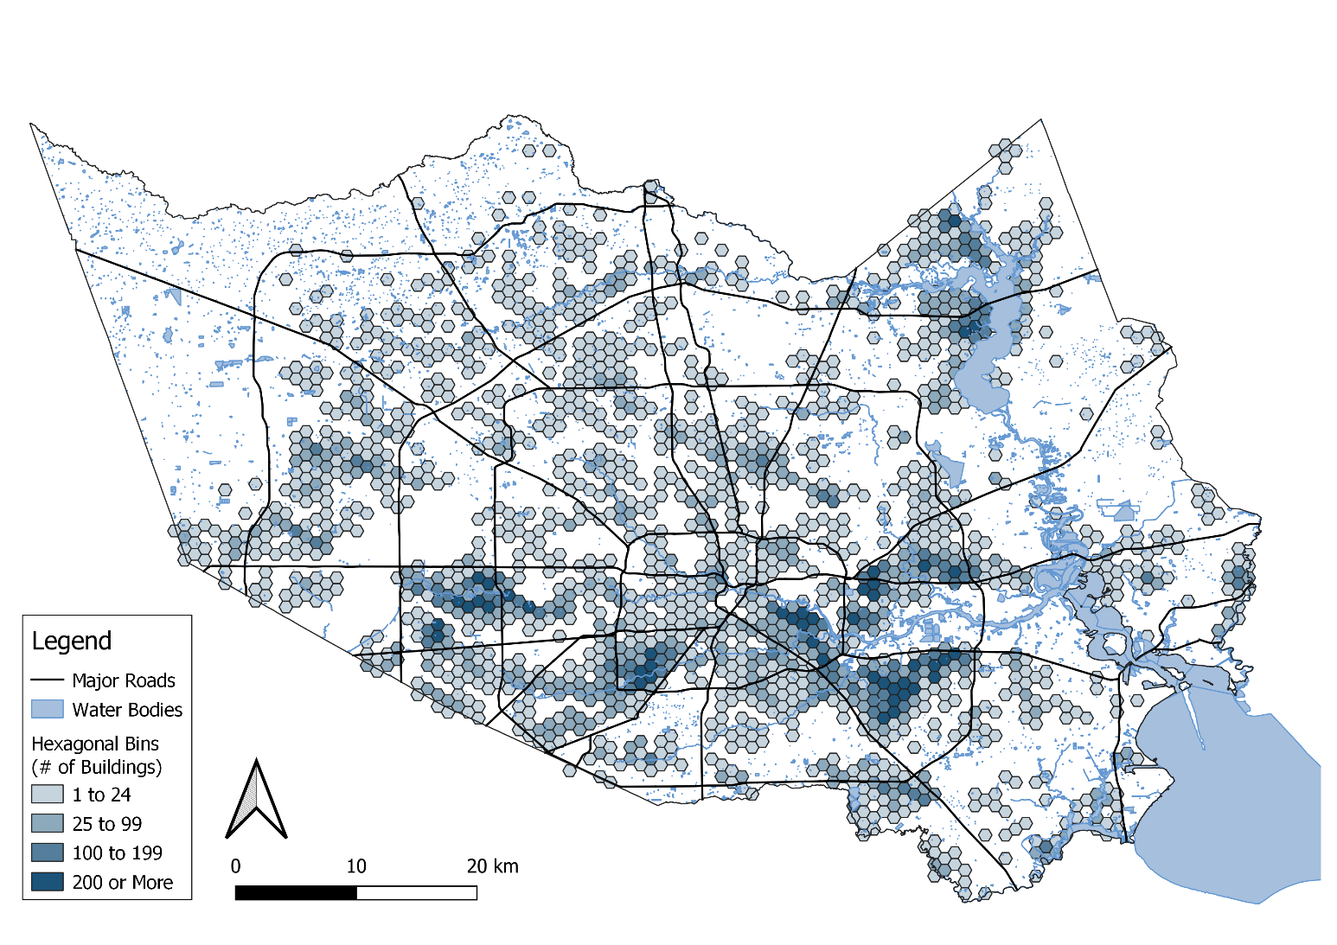


Social Inequalities in Climate Change-Attributed Impacts of Hurricane Harvey
We use our previous attribution studies of the human induced increases in precipitation and resulting flood increase paired with detailed land-parcel data to estimate climate change-attributed property damages during Hurricane Harvey in Harris County, Texas. We also use census tract socio-economic data to describe the socio-spatial characteristics of these climate change-induced impacts.
We show that 30 to 50% of the flooded properties would not have been flooded without climate change. Climate change-attributed impacts were particularly felt in low income Latina/x/o neighborhoods. While the chances of climate change induced damages were higher within FEMA’s 100-year floodplain, the social inequalities were greater outside this floodplain.
Climate Change-Attributed Flooding of buildings (38% Scenario) in Harris County, Texas during Hurricane Harvey.
This work, together with our earlier studies, is the first end-to-end attribution study of the human induced impacts of an extreme weather event. Fossil fuel consumption raised temperatures. Warmer temperatures increased precipitation amounts. Increased precipitation caused more flooding. Increased flood area and depth damaged more houses. This “bottom up” storyline analysis used to quantify human induced loss and damages and the disparate distribution of Harvey’s impacts amongst socio-economic groups is generalizable to other events and provides an alternative to “top down” macro models.
Kevin T. Smiley, Ilan Noy, Michael Wehner, Dave Frame, Christopher Sampson and Oliver E.Wing (2022) Social Inequalities in Climate Change-Attributed Impacts of Hurricane Harvey. Nature Communications 13, 3418 (2022)

