Slide 1
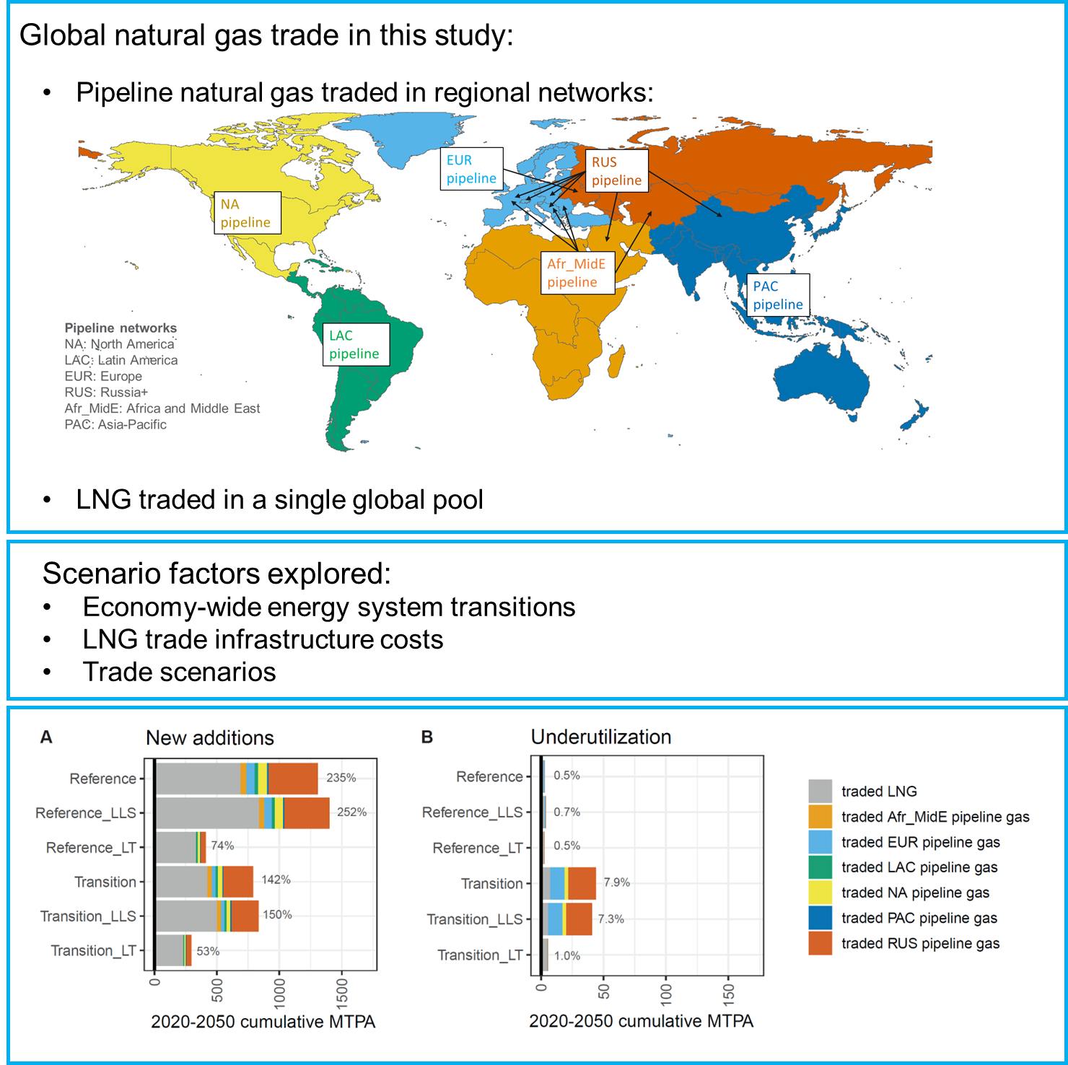
Natural Gas Trade in a Global Multi-Sectoral Model
Objective
Liquefied natural gas (LNG) is rapidly emerging as a technological system with the potential to expand global natural gas trade to large scales.
Build the new modeling capability required for analyzing long-term evolution of global natural gas trade and investments in pipeline and LNG trade infrastructure under a range of factors.
Approach
Developed a capability within the Global Change Analysis Model (GCAM) to differentiate pipeline gas and LNG trade.
Allowed for the tracking of natural gas export and import infrastructure investments over time.
Integrated gas trade into the broader global energy sector, allowing for competition between these two modes of gas trade with multiple energy supply technologies in meeting multi-sectoral energy demands.
Impact
Quantified potential investment levels in natural gas trade infrastructure—including LNG and pipelines—across regions under a range of factors.
In our modeled scenarios, new LNG export infrastructure ranged from 230 to 840 million tons of gas per annum (MTPA) globally by 2050. New pipeline export infrastructure ranged from 70 to 620 MTPA by 2050.
GCAM’s new detailed natural gas trade capability differentiates between pipeline and LNG trade and allows for the quantification of new investments and underutilization of gas trade infrastructure.
Scenario factors: LLS = Low liquefaction and shipping costs; LT = Limited trade. Units: MTPA = million tons of gas per annum (in gaseous form) that can be traded.
Yarlagadda, B., G. Iyer, M. Binsted, P. Patel, M. Wise and J. McLeod (2024). The future evolution of global natural gas trade. iScience. https://doi.org/10.1016/j.isci.2024.108902
Notes:
http://www.pnnl.gov/science/highlights/highlights.asp?division=749

