Slide 1
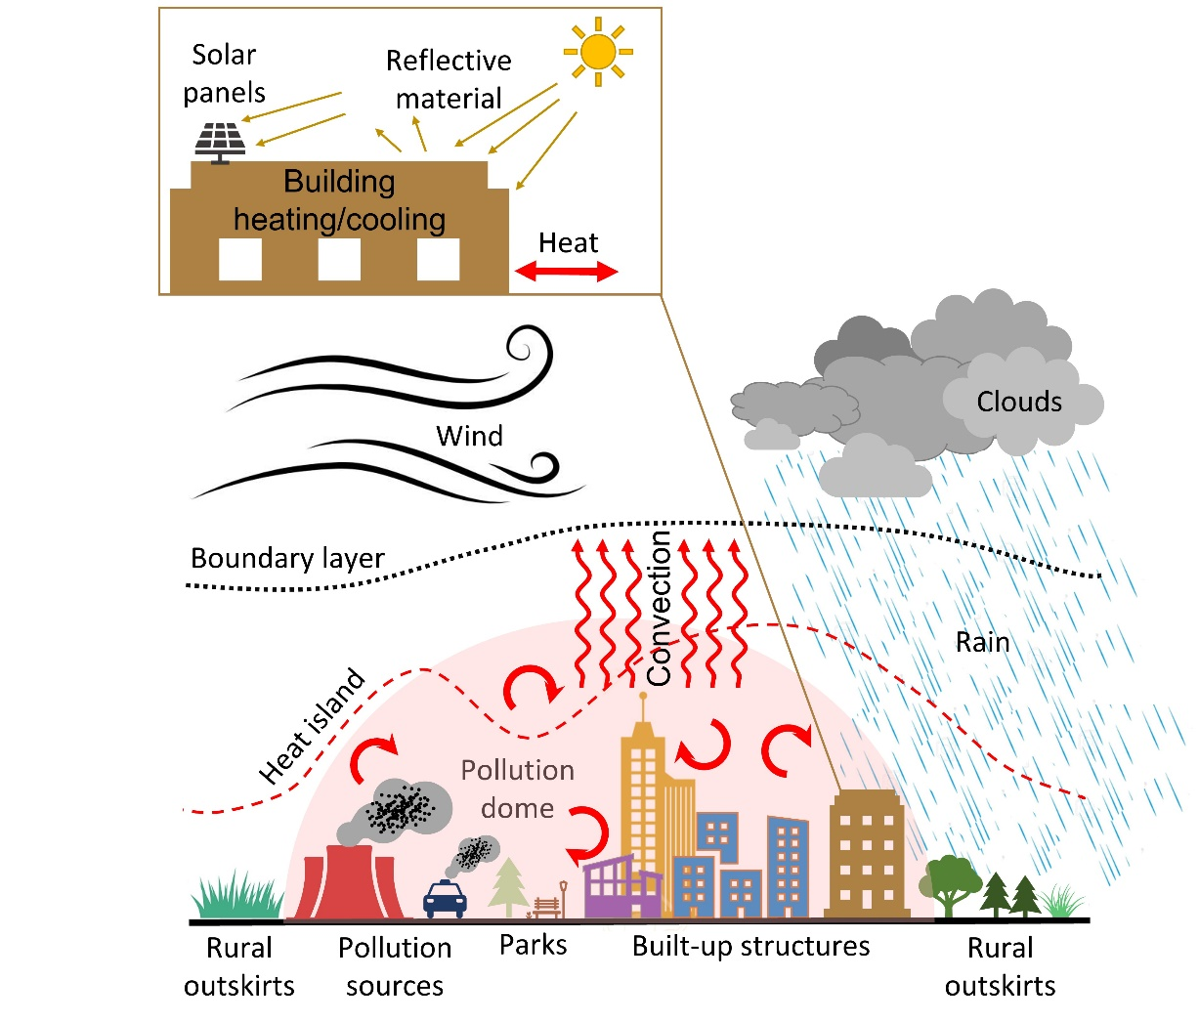
Reviewing Urban Impact on Regional Climate and Extreme Weather
Objective
Summarize the scientific literature on the impact of urbanization on extreme weather and regional climate.
Approach
Examine over 500 published studies focused on urbanization and its impacts on weather and climate. This includes urban heat islands and heat waves, atmospheric moisture, wind, boundary-layer, air pollution, clouds, precipitation, and storms.
Provide overviews of the main methods and datasets used to study urban areas from both observational and modeling perspectives.
Describe the limitations and uncertainties of different methods based on the scientific literature, identifying major research gaps.
Impact
Synthesized current scientific understanding of the many local and regional effects of urbanization.
Identified research gaps and provided recommendations on potential research topics and priorities for advancing the science around urbanization’s impact on weather and climate.
A schematic summarizing the impacts of urbanization on various components of natural and human systems. Urban environments have unique biophysical, morphological, and thermodynamic characteristics due to the continued infrastructure development that generally replaces natural landscapes with built-up structures.
Qian, Y., T. Chakraborty, J. Li, D. Li, C. He, C. Sarangi, F. Chen, X. Yang, L. R. Leung 2022, Urbanization Impact on Regional Climate and Extreme Weather: Current Understanding, Uncertainties, and Future Research Directions. Adv. Atmos. Sci. (2022).[DOI: 10.1007/s00376-021-1371-9]

Slide 2
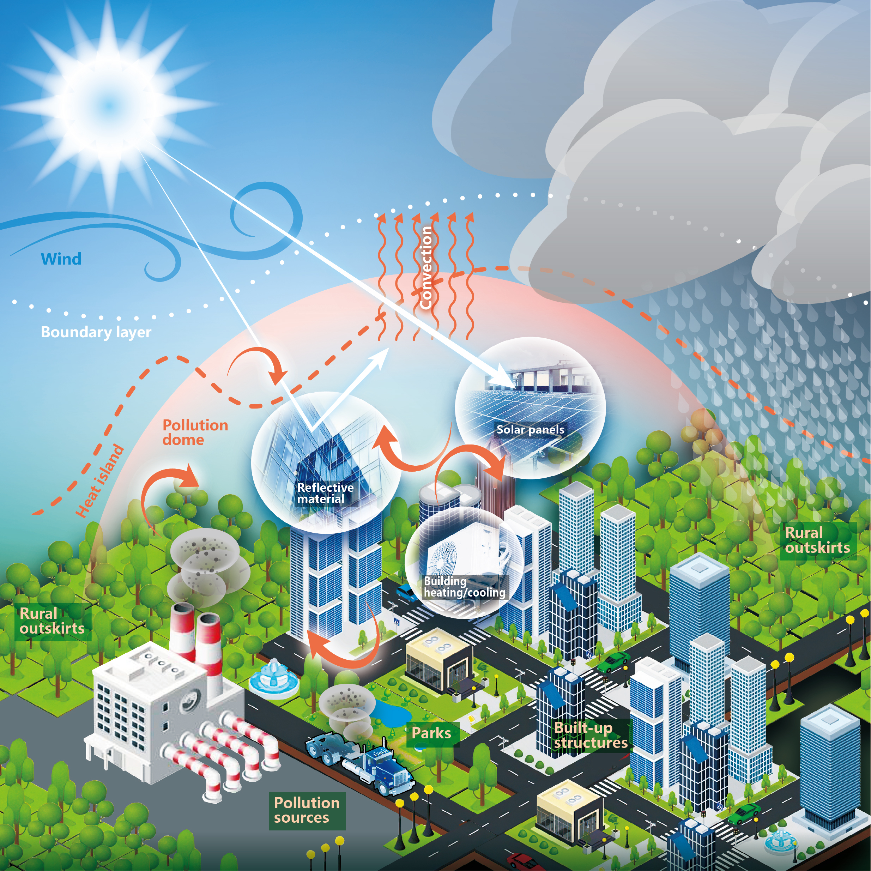
Journal cover image
Qian et al., 2022
Qian, Y., T. Chakraborty, J. Li, D. Li, C. He, C. Sarangi, F. Chen, X. Yang, L. R. Leung 2022, Urbanization Impact on Regional Climate and Extreme Weather: Current Understanding, Uncertainties, and Future Research Directions. Adv. Atmos. Sci. (2022). https://doi.org/10.1007/s00376-021-1371-9
Notes:
The U.S Department of Energy Office of Science, Biological and Environmental Research supported this research as part of the Regional and Global Modeling and Analysis program, the Multi-Sector Dynamics Modeling program and the Earth System Model Development program, through the collaborative, multi-program Integrated Coastal Modeling (ICoM) project, HyperFACETS project and COMPASS-GLM project. PNNL is operated for the Department of Energy by Battelle Memorial Institute under contract DE-AC05-76RL01830.

