Slide 1
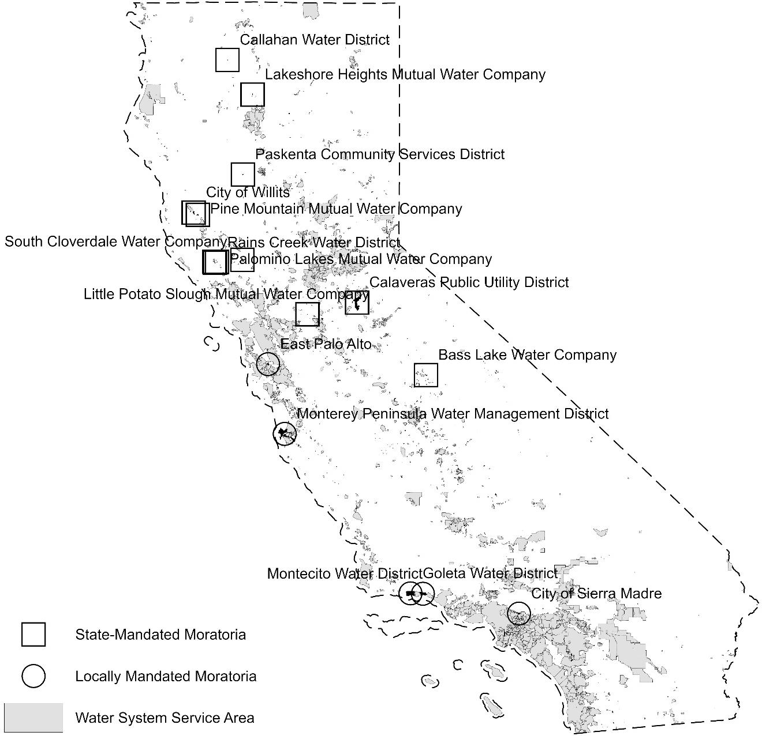
Impacts of Water-Related Building Moratoria on California's Housing Crisis
Objective
California faces dual crises of housing shortage and water scarcity. While efforts to increase housing supply aim to address affordability, water-related building moratoria, enacted during droughts, restrict development in areas lacking sufficient water. This study explores the tradeoffs by analyzing how these moratoria impact housing supply and prices.
Approach
This study combines data on the location and timing of California's water-related building moratoria (2010-2018) with parcel-level housing and sales data to assess their impact on housing supply and prices. Using an event-study difference-in-differences model, we compare new home builds before and after moratoria for systems that implemented them versus those that did not and applies the same approach to analyze how supply restrictions impact housing prices.
Impact
We find that the short-term impact of the moratoria on housing supply is small, but the effect grows over time and becomes more significant in later years, especially for locally mandated moratoria. We do not, however, find that these supply shocks have had an impact on housing prices.
Figure: Boundaries of Public Water Systems' Service Areas and the Systems Affected by State- and Locally Mandated Moratoria Over the Period 2010 to 2018
Impacts of Water-Related Building Moratoria on California’s Housing Crisis Land Economics Sep 2024, 112023-0122R. DOI: 10.3368/le.101.1.112023-0122R

