Slide 1
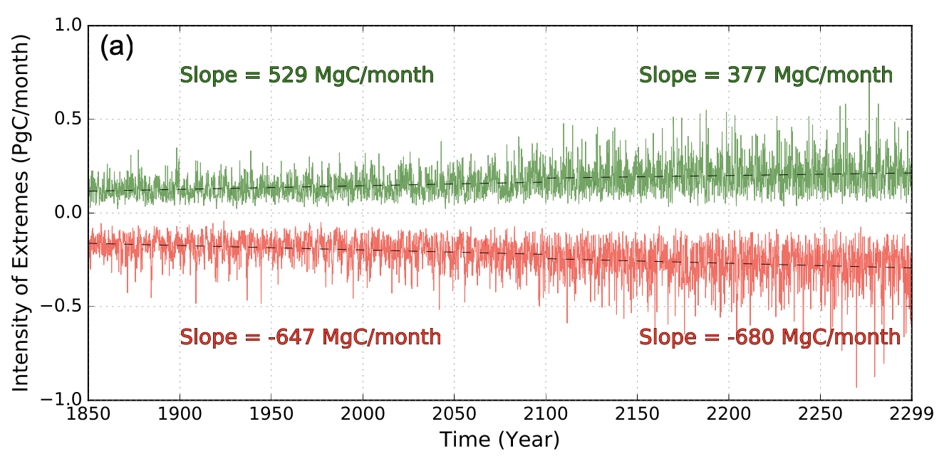
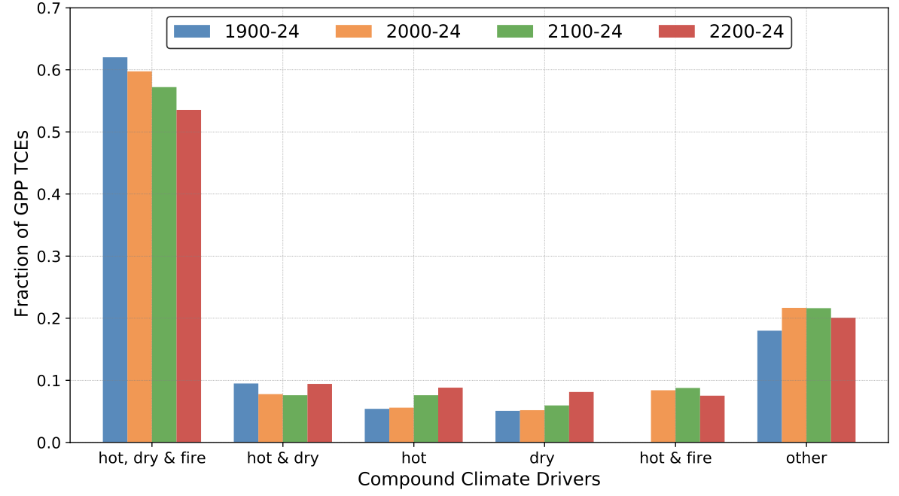
Land Use Change Intensifies Negative Carbon Cycle Extremes
Objective: To identify and quantify carbon cycle extremes under climate change and land use and land cover change (LULCC) through the year 2300
Approach: We analyzed long-term Community Earth System Model (CESM1-BGC)
simulations to the year 2300 under the RCP8.5+ECP8.5 scenario (atmospheric CO₂ exceeds 1960 ppm before stabilization) with and without LULCC forcing
Results/Impacts:
The rate of growth in the magnitude of negative carbon cycle extremes exceeds that of positive carbon cycle extremes by 1.8×
LULCC magnifies the intensity, frequency, and extent of carbon cycle extremes, leading to greater losses in global plant productivity
Precipitation declines are the dominant trigger for extremes in gross primary production, and reduced soil moisture leads to greater productivity reductions
The compound effect of soil moisture, temperature and fire drives more than 50% of all negative carbon cycle extremes
CO₂ only
CO₂ + LULCC
Top: The intensity of carbon extremes increases under climate change.
Bottom: Compound climate extremes drive more than half of negative carbon cycle extremes.
Sharma, Bharat, Jitendra Kumar, Nathan Collier, A. R. Ganguly, and Forrest M. Hoffman (2022), Quantifying Carbon Cycle Extremes and Attributing Their Causes Under Climate and Land Use & Land Cover Change from 1850 to 2300, J. Geophys. Res. Biogeosci., 127(6), e2021JG006738, doi:10.1029/2021JG006738.
Notes:
Extremes in GPP were defined by percentile based thresholds of global GPP anomalies. For attribution, the time continuous extremes in GPP were correlated with climate drivers at multiple lags.

