Slide 1
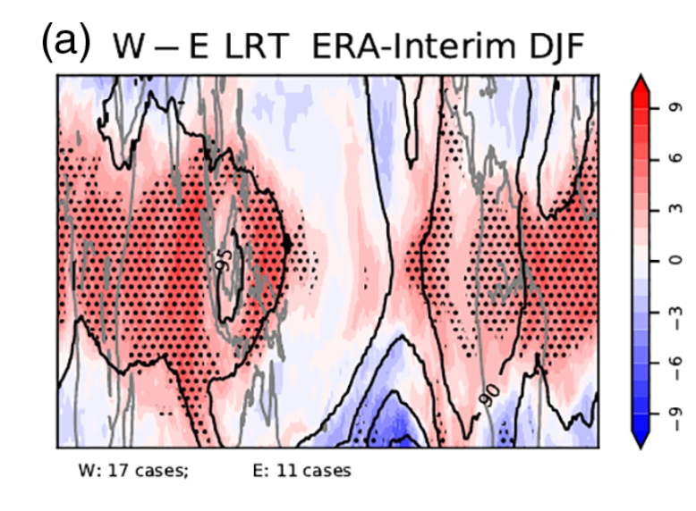
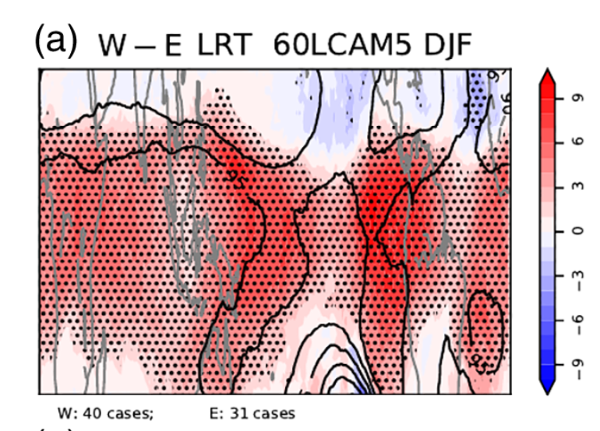
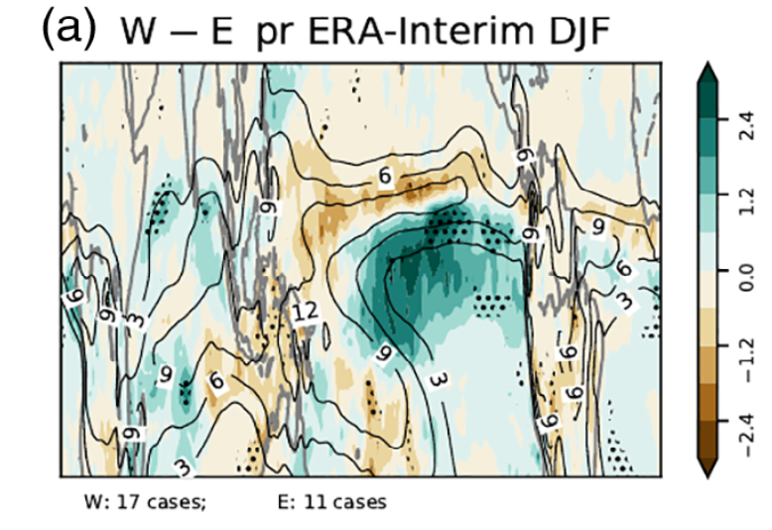
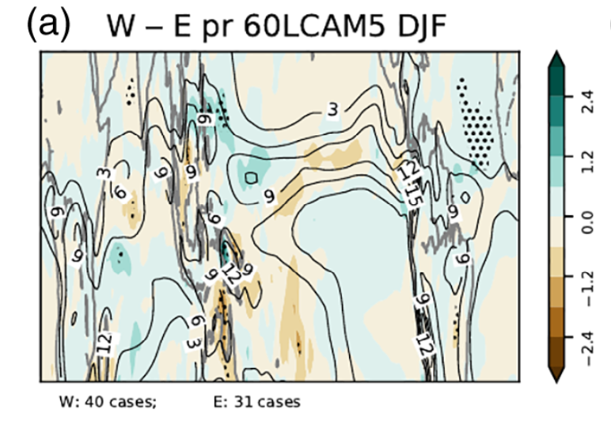
The impact of the QBO on the region of the tropical tropopause in QBOi models: Present-day simulations
F. Serva, … J.H. Richter et al. (2022):
QJRMS: DOI: 10.1002/qj.4287
OBJECTIVE
To evaluate the impact of the Quasi-Biennial Oscillation (QBO) on the tropical tropopause region and surface precipitation patterns.
APPROACH
We examined a multi-model ensemble of QBO-resolving global models participating in Phase 1 of the QBO Initiative (QBOi).
IMPACT
Processes occurring the tropical tropopause layer (TTL) are of great importance for stratosphere-troposphere exchanges and the variability of the Earth’s climate, including variability of surface precipitation. We examine here QBO impacts on the TTL region, tropopause pressure and surface precipitation. Overall, we find that the QBOi models have limited ability to reproduce the observed modulation of the TTL processes which is consistent with biases in the vertical and latitudinal extent of the simulated QBOs degrading this connection.
Top: QBO W - QBO E near-tropopause DJF pressure for ERA-I (left) and 60LCAM5 (right). Bottom: Same as top but for precipitation

