Slide 1
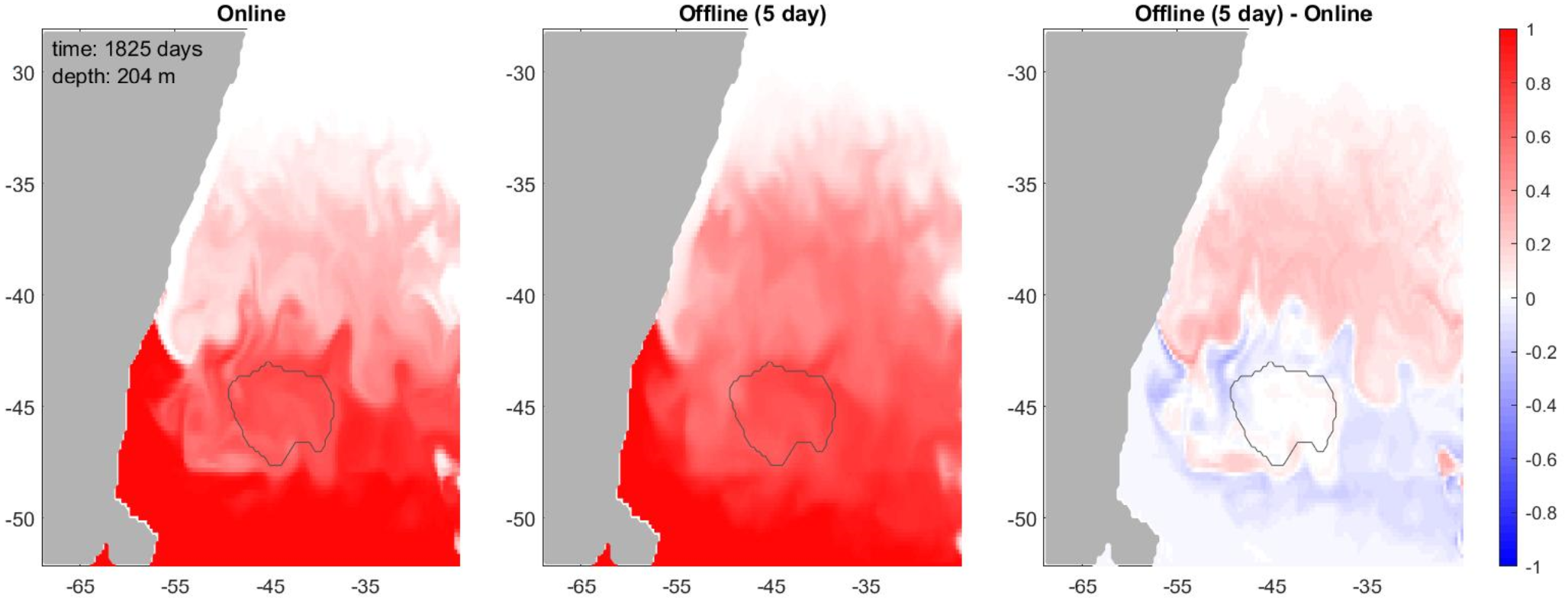
FEOTS: A novel tool for calculating tracer distributions in the ocean
Objective
We develop a new tool to efficiently calculate tracer distributions in an eddying ocean model.
We demonstrate this capability for the Argentine Basin where waters from different origins are exchanged by the global ocean circulation and mixed by intense eddy activity.
Research
The Fast Equilibration of Ocean Tracers Software (FEOTS) enables offline tracer calculations using the Transport Matrix Model (TMM) approach.
We diagnosed transport operators from a 5-year simulation with E3SMv0-HiLAT in a unique eddy-permitting configuration (0.3°).
We used these operators in FEOTS to calculate tracer distributions in an eddy-dominated region of the ocean, namely the Argentine Basin.
Offline tracer calculations are more diffusive than their online counterparts, due to flux-limiting of the advection operator in POP2.
FEOTS has the potential to become an efficient and accurate tool for tracer calculations, but some more work is needed.
Impact
Simulating passive tracers (tracers that do not affect the flow) with full-blown global GCMs is expensive.
For the first time, we apply a TMM to calculate tracer distributions in an eddying ocean model.
Comparing online and offline tracer simulations. Tracer distribution in the Argentine Basin from a 5-year simulation with E3SMv0-HiLAT (online, left) and FEOTS (offline, center). The offline simulation shows a similar impact of eddies on tracer distributions as the online simulation, although the features are more diffuse. The gray contour shows the boundary of the Zapiola Anticyclone, a major eddy-driven circulation feature in the Argentine Basin.
Schoonover, J., Weijer, W., & Zhang, J. (2023). FEOTS v0. 0.0: a new offline code for the fast equilibration of tracers in the ocean. Geoscientific Model Development, 16(10), 2795-2809. https://doi.org/10.5194/gmd-16-2795-2023.

