Slide 1
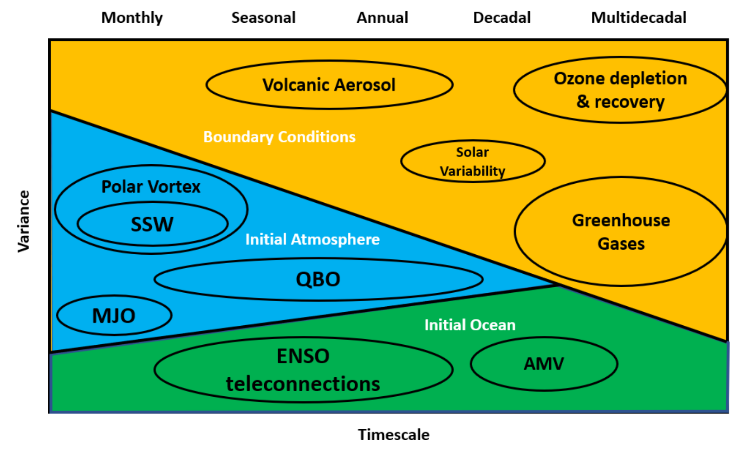
Long-range prediction and the stratosphere (Review paper)
Scaife, A. A., … J. Richter, et al. (2022): Atmos. Chem. Phys. https://doi.org/10.5194/acp-22-2601-2022
OBJECTIVE
To provide an overview of how the inclusion of the stratosphere in forecast systems aids monthly, seasonal, and annual-to-decadal climate predictions and multi-decadal projections.
Role of the stratosphere in long-term prediction
APPROACH
Literature review of historical and recent advances on this topic, ending with an outlook towards the future and identification of areas of improvement that could benefit long-term predictions.
IMPACT
The stratospheric state affects predictability on subseasonal to multi-decadal timescales. The state of the stratospheric polar vortex, including sudden stratospheric warmings, affect surface prediction, especially the North Atlantic Oscillation (NAO) on subseasonal time-scales. The stratospheric quasi-biennial Oscillation (QBO) affects the Madden-Julian Oscillation (MJO) on monthly time-scales, and the NAO and ENSO teleconnections on monthly to annual timescales. Stratospheric volcanic aerosols, solar variability, ozone and greenhouse gas concentrations become important for longer term predictions. Improved representation of the observed stratospheric-tropospheric teleconnections would likely improve tropospheric prediction on all timescales.

