Slide 1
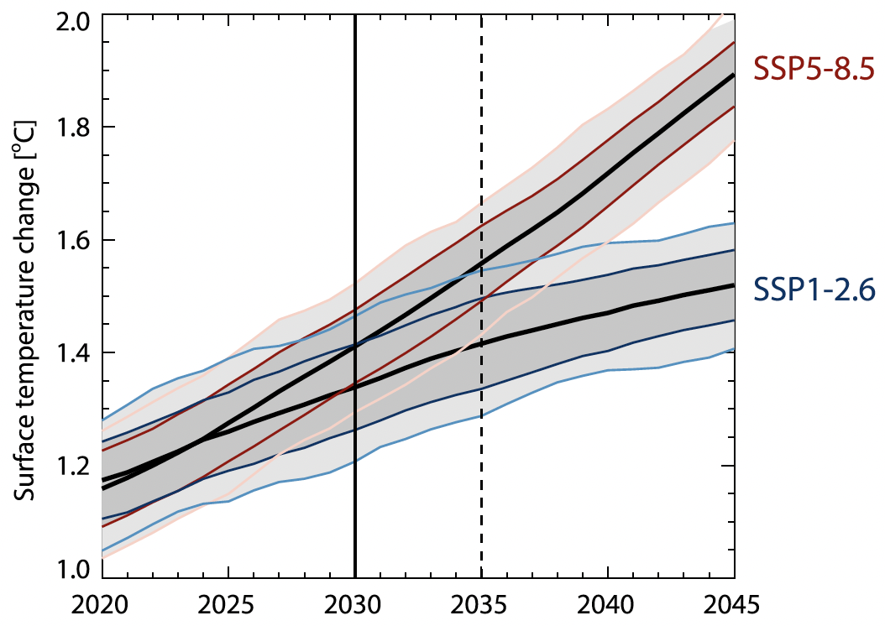
Speeding up detection of climate response to emission reductions
Scientific Achievement LLNL scientists and colleagues have used a novel technique to filter out short-term contributions to the global warming rate arising from natural climate variability, thereby allowing them to better extract the underlying global warming signal. This allows them to more clearly see the steady upward trend in temperature caused by past greenhouse gas emissions, and to better detect changes in the warming rate such as those that may occur in response to any future emissions reductions.
Significance & Impact
The noise of natural climate fluctuations hinders timely detection of a change in the global warming rate from measurements. The new climate variability filter cuts this detection time in half, providing crucial confirmation that emission reductions are having an observable effect on global climate. This filtering process also makes it clear that the past warming rate has been very steady at roughly 0.2˚C per decade since 1970; its has neither slowed or accelerated in recent years, as has been suggested by some researchers.
Earlier detection
Mean and ±1 standard deviation ranges of a 10-member MPI-ESM1.2 ensemble, for raw (light shading) and filtered (dark shading) global surface temperature anomalies for two emissions scenarios. Vertical lines show the year of emergence in the filtered (solid) and unfiltered (dashed) case.
Research Details The team used a physics based Green’s function approach to filter out modulations to global mean surface temperature from sea-surface temperature patterns. This allowed them to extract the inherent underlying trend in global temperature without the obfuscating effects of natural variations. The filtered temperature changes rates allow for an earlier detection of the response to strong emissions mitigation.
Samset, B., C. Zhou, J. Fuglestvedt, M. Lund, J. Marotzke, M. D. Zelinka, 2022: Earlier emergence of a temperature response to mitigation by filtering annual variability, Nature Communications, 13, 1578, doi:10.1038/s41467-022-29247-y.
Notes:
The Science
Lawrence Livermore National Laboratory scientists and colleagues at CICERO Center for International Climate Research, Nanjing University, Max Planck Institute for Meteorology, and Universität Hamburg have used a novel technique to filter out short-term contributions to the global warming rate arising from natural climate variability, thereby allowing them to better extract the underlying global warming signal. This allows them to more clearly see the steady upward trend in temperature caused by past greenhouse gas emissions, and to better detect changes in the warming rate such as those that may occur in response to any future emissions reductions.
The Impact
Natural climate fluctuations like El Niño and La Niña create significant “noise” that can mask the underlying “signal” of human-caused temperature changes. This complicates the seemingly simple task of detecting a change in the global warming rate, especially on short timescales of a decade or less. The noise from internal variations means that – up until now – verification of a change in warming rate from measurements could take up to 20 years. The new climate variability filter developed in this study cuts this time in half. This will provide crucial confirmation that emission reductions are having an observable effect on the global climate system – information that might otherwise be masked by the noise of natural climate fluctuations. This filtering process also makes it clear that the past warming rate has been very steady, at roughly 0.2˚C per decade since 1970. The rate has neither slowed or accelerated in recent years, as has been suggested by some researchers.
Summary
The rate of global surface warming is crucial for tracking progress towards global climate targets, but is strongly influenced by interannual-to-decadal variability, which precludes rapid detection of the temperature response to emission mitigation. Here we use a physics based Green’s function approach to filter out modulations to global mean surface temperature from sea-surface temperature (SST) patterns, and show that it results in an earlier emergence of a response to strong emissions mitigation. For observed temperatures, we find a filtered 2011–2020 surface warming rate of 0.24 °C per decade, consistent with long-term trends. Unfiltered observations show 0.35 °C per decade, partly due to the El Nino of 2015–2016. Pattern filtered warming rates can become a strong tool for the climate community to inform policy makers and stakeholder communities about the ongoing and expected climate responses to emission reductions, provided an effort is made to improve and validate standardized Green’s functions.

