Slide 1
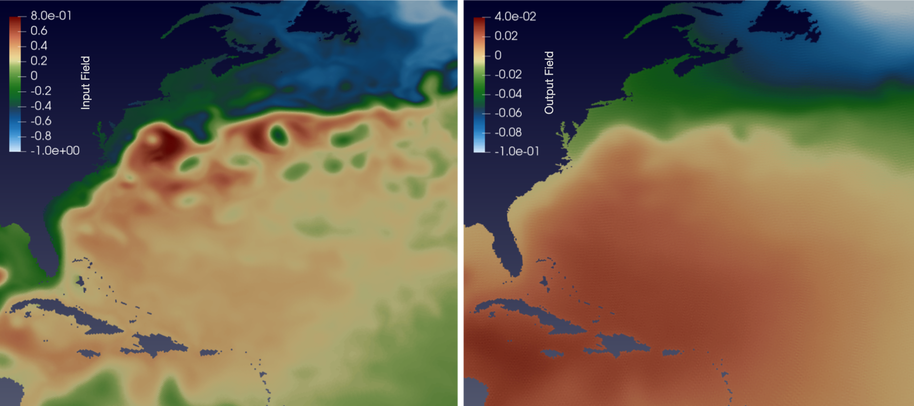
Improving Tidal Modeling with Self-Attraction and Loading
Objective
Improve the accuracy of tides in the Model for Prediction Across Scales-Ocean (MPAS-Ocean) by using a computationally-efficient method of calculating the self-attraction and loading (SAL) term.
Approach
Use a fast spherical harmonics transform package to evaluate SAL.
Run MPAS-Ocean using either the scalar approximation of SAL or the spherical harmonic formulation on both uniform and variable resolution meshes.
Document the computational performance and evaluate tidal accuracy by calculating the root-mean-square error against benchmark tidal datasets.
Impact
Using the spherical harmonic formulation improves tidal accuracy by up to 40% as compared to the scalar approximation.
The computational cost of SAL can be reduced by updating the term in 10 to 30-minute intervals without creating additional tidal error.
Using a global 45-to-5 km variable resolution mesh improves computational performance and reduces error compared to an 8 km quasi-uniform mesh.
The perturbation to the sea-surface height from SAL, right, given an input field on the left (in meters). The scalar approximation simply uses a scalar multiple of the field on the left. However, the SAL term should be spatially smoothed compared to the input as demonstrated by the figure on the right. Including this more realistic SAL improves the tides calculated in the model compared to the approximation.
K.N. Barton, et al. “Global barotropic tide modeling using inline self-attraction and loading in MPAS-Ocean,” Journal of Advances in Modeling Earth Systems, 14, e2022MS003207 (2022). [DOI: 10.1029/2022MS003207]

