Slide 1
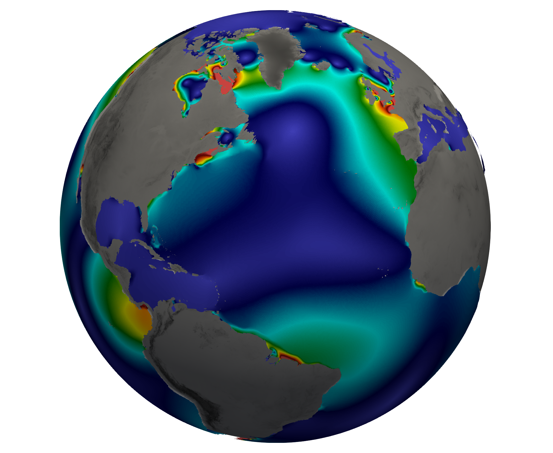
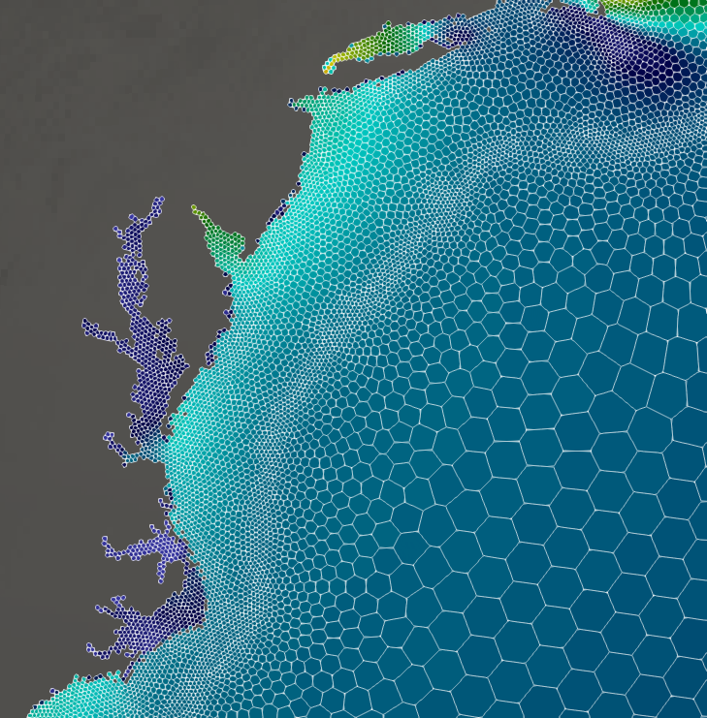
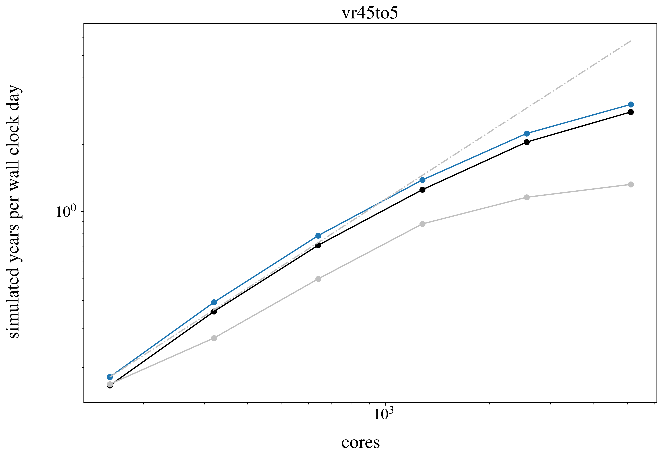
Faster Self-Attraction and Loading for Variable Resolution Ocean Models
Objective
Develop an efficient and scalable algorithm for computing the effect of mass anomalies due to tides on tidal dynamics for ocean models that use variable resolution meshes.
Approach
Compute self-attraction and loading (SAL) effects directly on the variable resolution mesh in parallel using the same mesh decomposition as the model’s other dynamical computations.
Compare this approach to standard method that interpolates the unstructured field to a structured mesh and employs an existing software library.
New, faster parallel version
Impact
Computational Throughput
(simulated years per wallclock day)
Approximate SAL
The parallel approach achieves higher error convergence rates and the computational throughput scales well with increasing processor counts.
Tidal simulations with SAL effects can be completed 4x more efficiently.
Original serial version
Cores
Brus, S. R., et al. “Scalable self attraction and loading calculations for unstructured ocean tide models,” Ocean Modelling, 182, 102160 (2023). [DOI: 10.1016/j.ocemod.2023.102160]
A new parallel methodology for computing SAL provides higher error convergence and increased scalability.
OSTI Identifier: 1923027

