Slide 1
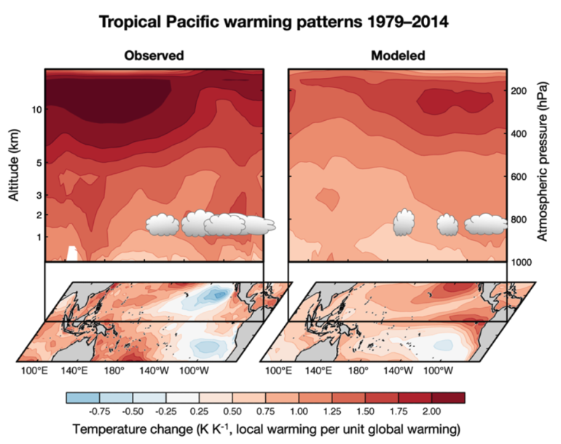
Patterns of Surface Warming Matter for Climate Sensitivity
Science Question
What is our current understanding of the pattern effect?
Whare are the key unanswered questions?
Where can progress be made on this critical topic?
Key Accomplishments
The team reviewed the physical mechanisms driving the pattern effect, implications for estimating and constraining climate sensitivity, and identified pressing unanswered questions, providing fodder for future research.
Impact
This commentary piece targeted a broad scientific audience, informing them of the importance of the pattern effect, its causes and implications, as well as areas in need of further research. It highlights the need for inter-disciplinary collaboration across numerous communities to continue making progress.
(left) The surface and vertical structure of warming observed over the past few decades in the tropical Pacific, characterized by strong warming in regions of deep convection (e.g., western Pacific) and cooling in parts of the eastern Pacific. This pattern favors extensive low-level cloud cover that reflects solar radiation and keeps Earth relatively cool. (right) Typical representation of warming simulated by models over this period, which differs from the observed one and favors less efficient radiative damping.
Rugenstein, M., M. D. Zelinka, K. Karnauskas, P. Ceppi, and T. Andrews, 2023: Patterns of Surface Warming Matter for Climate Sensitivity, Eos, 104, doi:10.1029/2023EO230411
Notes:
The Science
PCMDI Scientists and colleagues at Colorado State University, University of Colorado Boulder, Imperial College London, and the Met Office Hadley Centre have highlighted the key historical developments, open questions, and promising avenues for progress in the study of the effect of surface warming patterns on Earth’s energy balance.
The Impact
As Earth warms, it sheds more heat to space via radiation, keeping the climate stable. However, the efficiency with which this occurs depends not only on how much the planet warms, but on the spatial pattern of that warming. This so-called “pattern effect” has huge ramifications for constraining climate sensitivity based on climate changes observed to date. The team reviews the state of the science on this topic, with an eye toward promising avenues, tools, and observations for future progress.
Summary
The authors review the state of the science on the pattern effect, which describes the dependence of Earth’s radiative energy balance on the spatial pattern of surface temperature change. Physical mechanisms driving the pattern effect, implications for estimating and constraining climate sensitivity, and pressing unanswered questions are provided, providing fodder for future research. The commentary concludes with a call for continued collaboration between the diverse communities studying relevant aspects of climate dynamics.

