Slide 1
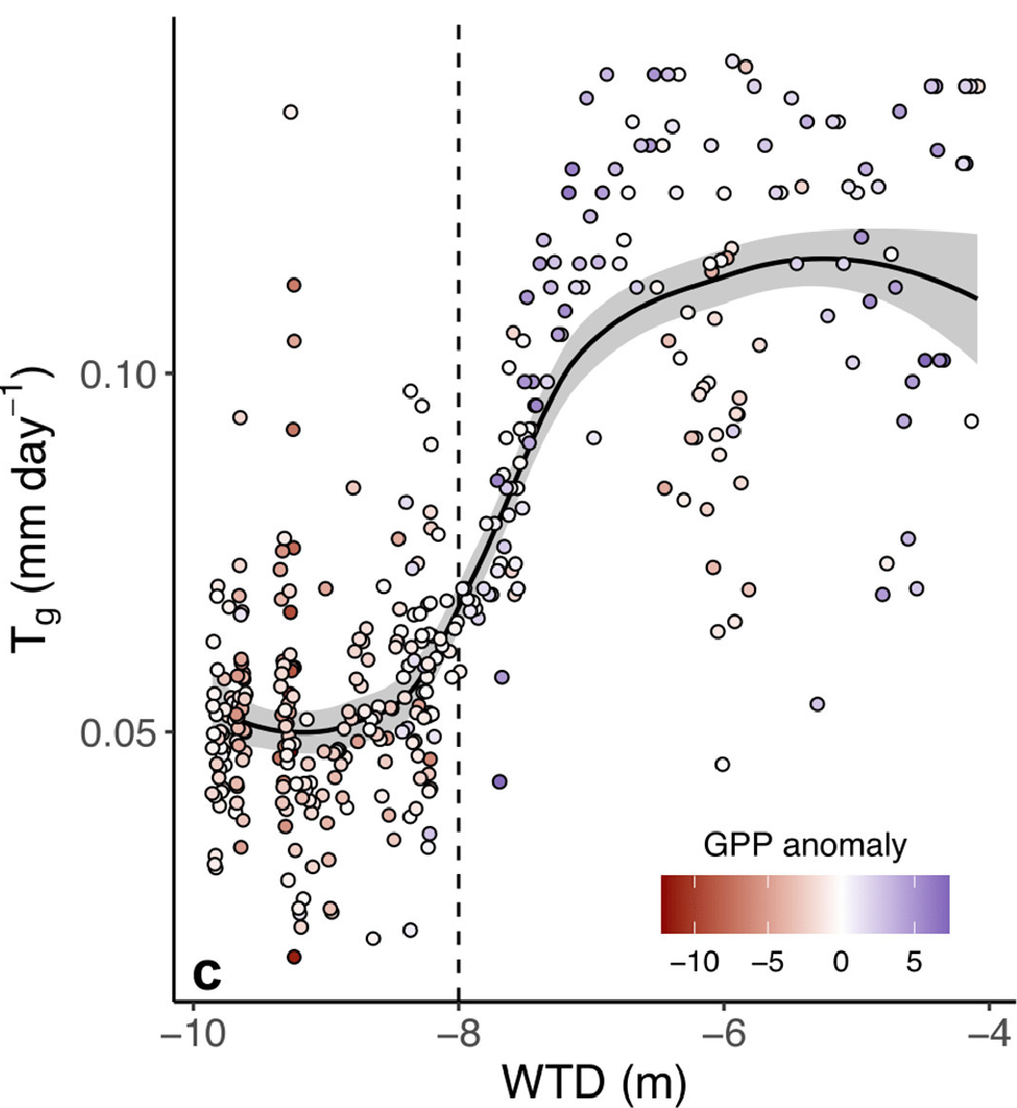

Ecosystem groundwater use enhances carbon assimilation and tree growth
Scientific Achievement
We show that daily ecosystem groundwater use increases under positive groundwater anomalies and is associated with increased carbon assimilation and evapotranspiration rates. Three machine learning algorithms better predict gross primary productivity and tree growth anomalies when trained using groundwater data.
Significance and Impact
Our results suggest that groundwater has a unique effect on carbon assimilation and allocation to woody growth. They demonstrate the importance of deep subsurface water resources to carbon assimilation and woody growth in dryland systems, as well as the benefits of collocated, long-term eddy covariance and ancillary datasets to improve understanding of complex ecosystem dynamics.
Fig. Continuous water table depth (WTD) levels correspond to groundwater-derived transpiration (Tg). WTD vs. Tg, colored by gross primary productivity anomalies (GPP) with a loess smooth (solid black line). Mean WTD over the course of the 20-year time series is –8 m (dashed line), which also corresponds to a threshold below which Tg and GPP anomalies are significantly diminished relative to shallower WTD, suggesting limited access to groundwater.
Research Details
We use 20 years of eddy covariance, groundwater, and tree growth measurements to isolate the impact of groundwater on carbon cycling in a semi-arid Mediterranean system in California during the summer dry season.
Ruehr S et al. (2023), Agricultural and Forest Meteorology
DOI: https://doi.org/10.1016/j.agrformet.2023.109725

