Slide 1
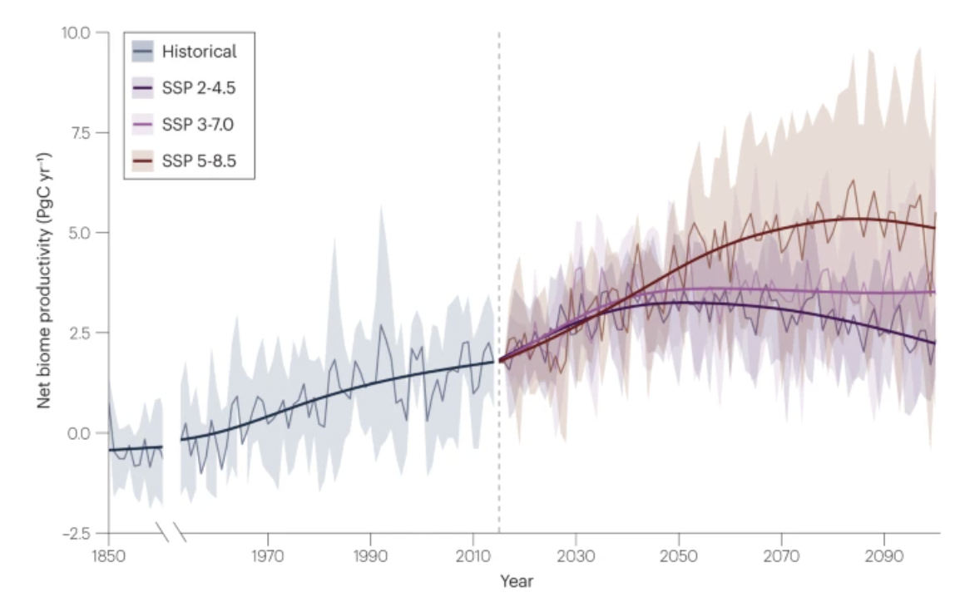

Evidence and attribution of the enhanced land carbon sink
Scientific Achievement
This study focuses on the mechanisms through which climate change has been partially mitigated by an increasing net land carbon sink in the terrestrial biosphere.
This sink has increased from 1.2 PgC yr−1 in the 1960s to 3.1 PgC yr−1 in the 2010s.
This trend results largely from carbon dioxide fertilization increasing photosynthesis, mainly in tropical forest regions, and elevated temperatures reducing cold limitation, mainly at higher latitudes.
Significance and Impact
Understanding the processes that drive long term increases in the land carbon sink is essential for protecting, managing and projecting this important ecosystem service.
Fig. Historical and future projections of the land carbon sink.
Multimodel mean changes in net biome productivity, which represents net ecosystem exchange aggregated over a large spatial and temporal extent and includes disturbance and land-use change, of terrestrial ecosystems from eight Coupled Model Intercomparison Project (CMIP6) models under historical (black) and Shared Socioeconomic Pathways (SSP; coloured) scenarios.
Research Details
We examine the evidence for and implications of an increased land carbon sink. First, we explore the evidence of land sink enhancement from various observations and methodologies. We then outline the processes driving this change, and discuss projected changes in the sink and associated implications for natural climate solutions and society. We end by outlining future research priorities to better understand and manage dynamic land carbon stocks and sinks.
Ruehr J et al. (2023), Nature Reviews
DOI: https://doi.org/10.1038/s43017-023-00456-3

