Slide 1
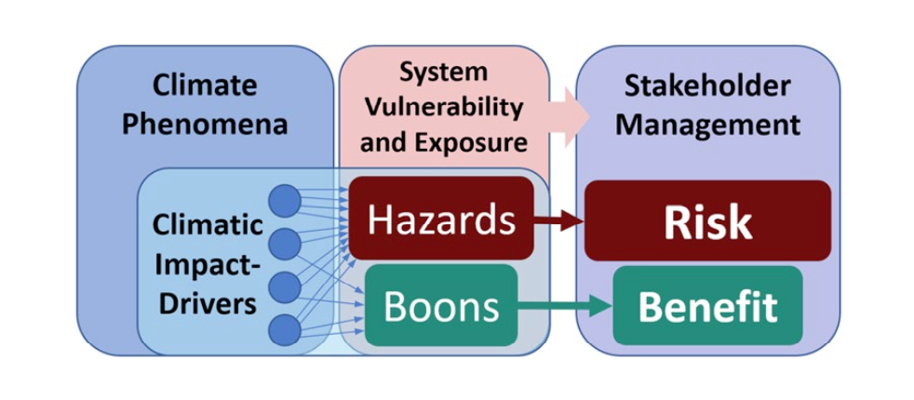
The Climatic Impact-Driver Framework for Assessment of Risk-Relevant Climate Information
Scientific Challenges
A broad, demand-driven concept is needed to represent physical climate conditions that affect human and natural systems. The concept that is traditionally used is that of a hazard, but a more neutral term is thought of being necessary, to accommodate those cases where climatic drivers have actually positive effects. Also, a degree of resolution and specificity is sought, to better organize and communicate between the two communities.
Approach and Results
Through interaction with the impact research community and analysis of its literature the concept of climatic impact-drivers was developed. Seven CID types (Heat and Cold, Wet and Dry, Wind, Snow and Ice, Coastal, Open Ocean, and a residual “Other”) further divided into 33 categories (for example, Mean air temperature, Extreme Heat, Cold spells and Frost under “Heat and Cold”) were identified as relevant to sectors and their interactions. For each of these categories, specific metrics and indices can be identified that are of concrete relevance to impacts and adaptation research.
Figure: Climatic impact-drivers (CID) capture select characteristics of climate conditions (e.g., means, events, and extremes) that are relevant for impacts and risk management. CIDs emerge from the combination of climate phenomena with information on vulnerability and exposure determining assets' climatic responses, which allows translation of CIDs into hazards (associated with risk) or boons (associated with benefits or opportunities) for stakeholder management.
Significance
This type of framework organized the assessment of impact-relevant climatic changes in the IPCC WG1 AR6 report (The physical Science basis) in order to facilitate the transfer of information to the sectoral chapters in WG2 (Impacts, Adaptation, Vulnerability).
It is expected that this framework will guide development of relevant climate information for use by stake-holders.
It is also hoped that it could help prioritize model development by identifying phenomena and variable of large importance for sectoral impacts.
Citation: Ruane, A. C., Vautard, R., Ranasinghe, R., Sillmann, J., Coppola, E., Arnell, N., et al. (2022). The Climatic Impact-Driver Framework for assessment of risk-relevant climate information. Earth’s Future, 10, e2022EF002803.
https://doi. org/10.1029/2022EF002803

