Slide 1
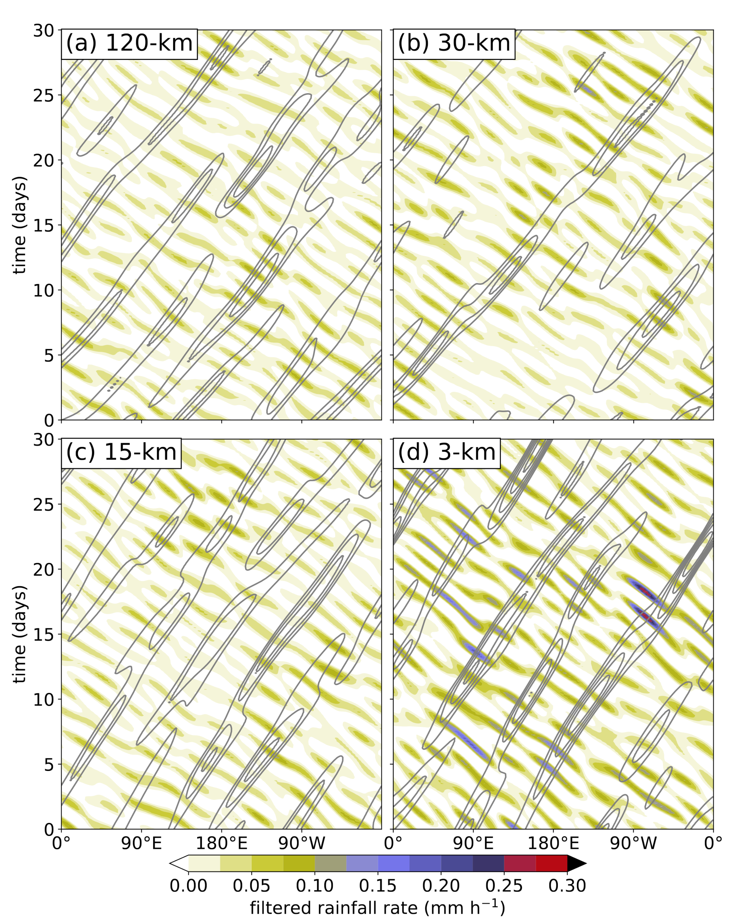
Differences in Tropical Rainfall in Aquaplanet Simulations with Resolved or Parameterized Deep Convection
Rios-Berrios, R., G. H. Bryan, B. Medeiros, F. Judt, & W. Wang J. Adv. Modeling Earth Sys., https://doi.org/10.1029/2021MS002902
Objective
Compare and contrast tropical rainfall variability in idealized simulations with parameterized versus explicit convection.
Approach
Use MPAS Atmosphere model in aquaplanet configuration.
Run with parameterized convection at grid cell spacing of 120km, 30km, adn 15km.
Run with explicit convection for a regionally refined configuration that has grid cell spacing of 15km in the extratropics and 3km in the tropical belt.
Apply a range of diagnostic tools from simple averages to event tracking to characterize tropical precipitation and its variability.
Impact
This paper documents a benchmark aquaplanet configuration that uses convection-permitting resolution in the tropical belt.
Allows a detailed examination of the impact of parameterized convection on tropical rainfall.
Shows that explicitly resolving convection leads to more intense rainfall, and greater equatorial wave variability in this model.
The stronger rainfall with explicit convection arises from convection organizing into more linear systems with deeper, stronger cold pools than with parameterized convection.
Hovmöller diagrams of filtered 6-hourly precipitation rate associated with westward inertio-gravity waves (shading) and Kelvin waves (contours) from MPAS-A simulations using (a) 120-km, (b) 30-km, (c) 15-km, and (d) 3-km cell spacing.

