Slide 1
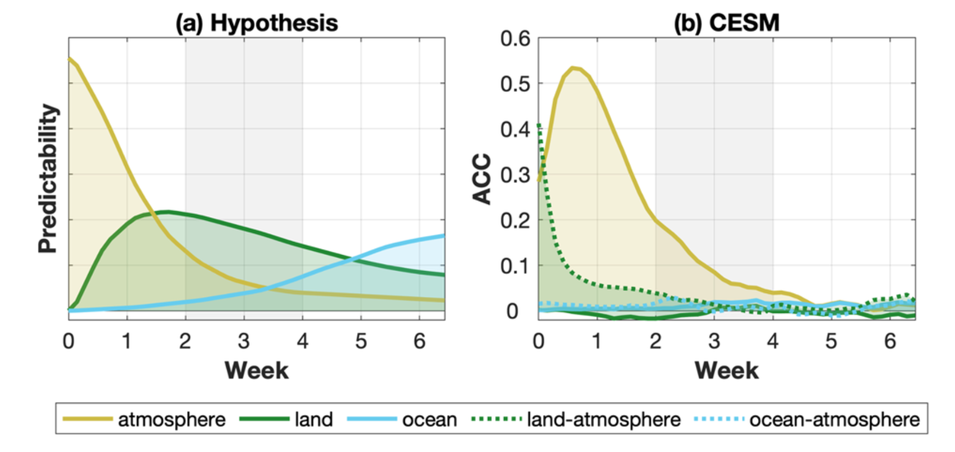
Quantifying sources of subseasonal prediction skill in CESM2
J. H. Richter, A. A. Glanville, …, Stephen G. Yeager … Julie M. Caron, et al.(2024): Nature Climate and Atmospheric Science, 7:59, https://doi.org/10.1038/s41612-024-00595-4
OBJECTIVE
To to quantify the respective roles of atmosphere, land, and ocean initial conditions on subseasonal prediction skill.
APPROACH
We use a unique suite of subseasonal reforecast experiments with CESM2 with initial conditions for one or more model components set to climatology.
IMPACT
The study revealed that the majority of prediction skill for global surface temperature in weeks 3–4 comes from the atmosphere, while ocean initial conditions become important after week 4, especially in the Tropics. In the CESM2 subseasonal prediction system, the land initial state does not contribute to surface temperature prediction skill in weeks 3–6 and climatological land conditions lead to higher skill, disagreeing with our current understanding. However, land-atmosphere coupling is important in week 1. Subseasonal precipitation prediction skill also comes primarily from the atmospheric initial condition, except for the Tropics, where after week 4 the ocean state is more important.
Sources of subseasonal predictability of temperature. Predictability coming from the atmosphere (yellow), land (green), and ocean (blue) as a function of forecast time for annual mean 2 m temperature from 30ºN to 60ºN over land regions only: a) Hypothesis, adapted from a graphic by Paul Dirmeyer7, (b) derived from CESM simulations Panel (b) includes additional two coupling terms: land- atmosphere (green dashed) and ocean-atmosphere (blue dashed).

