Slide 1
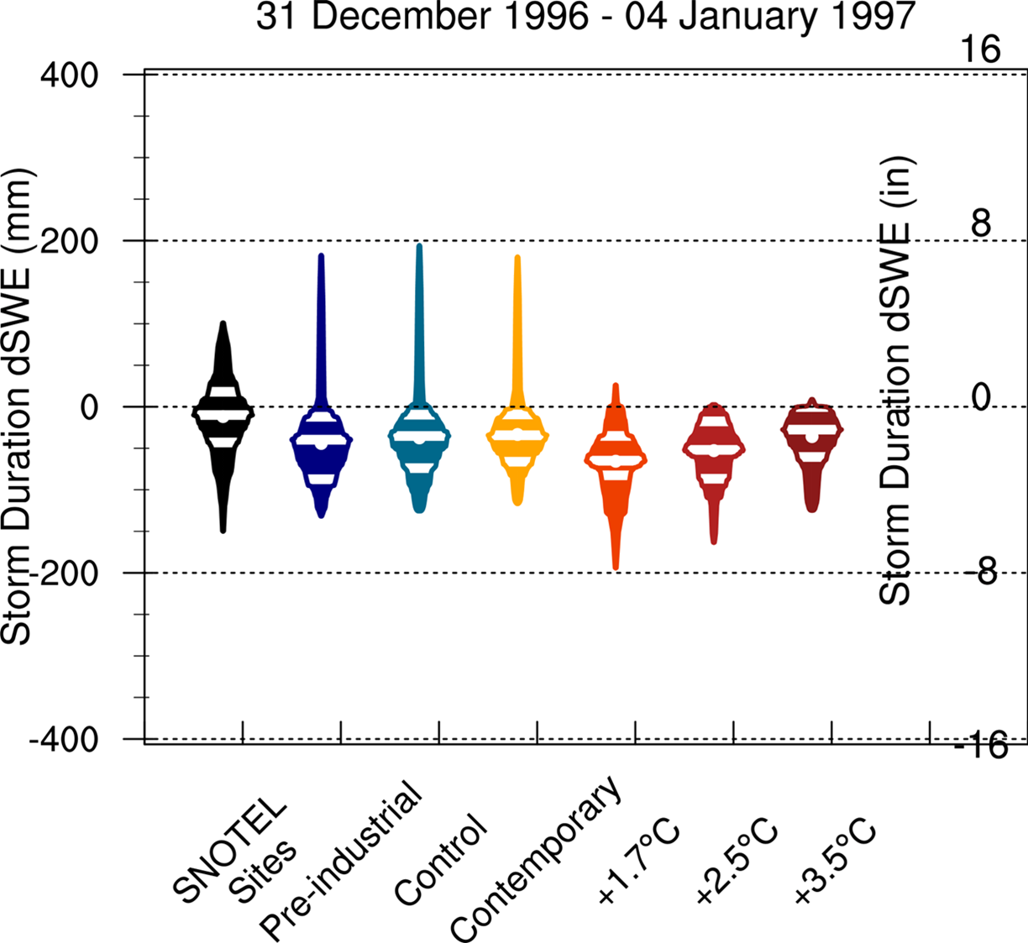
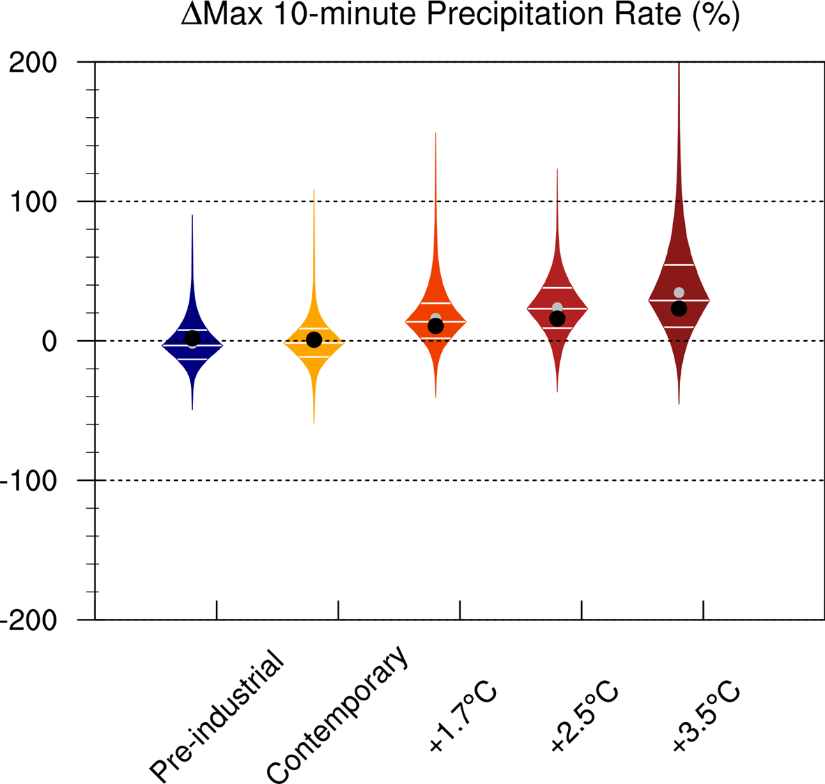
Anticipating How Rain-on-Snow Events Will Change through the 21st Century: Lessons from the 1997 New Year’s Flood Event
Scientific Challenges
Figure: the 1997 flood drivers differentially respond to warming. The atmospheric river becomes more hazardous (left map plots), snowpack systematically decreases (top right violin plots), and short duration, high intensity rainfall increases, often exceeding theoretical scaling expectations (bottom right violin plots)
The 1997 California-Nevada New Year's flood event caused over $1B in damages and remains a water management design storm (1-in-100 year). Extreme precipitation, snowmelt, and saturated soils produced heavy runoff and caused widespread inundation in the Sacramento Valley. A key challenge is understanding how these design storms have already responded to climate change and how much worse they might become in a warmer future.
Pre-industrial
Approach and Results
Control
We test the regionally refined mesh enabled Energy Exascale Earth System Model’s (RRM-E3SM) ability to reforecast the flood event in past, present and future climates using Betacast. This testing ensures that RRM-E3SM can provide value in anticipating and planning for future flood events, particularly given the changing climate and how flood drivers might differentially respond to warming.
Citation: Rhoades, A.M., C.M. Zarzycki, B.J. Hatchett, H. Inda-Diaz, W. Rudisill, B. Bass, E. Dennis, A. Heggli, R. McCrary, S. McGinnis, M. Ombadi, S. Rahimi-Esfarjani, E. Slinskey, A. Srivastava, J. Szinai, P.A. Ullrich, M.F. Wehner, D. Yates, and A.D. Jones (2024)
Anticipating How Rain-on-Snow Events Will Change through the 21st Century: Lessons from the 1997 New Year’s Flood Event. Clim Dyn (2024). https://doi.org/10.1007/s00382-024-07351-7
+1.7°C
Significance
Due to precipitation interactions with snowpack and soil moisture, flood hazard for this RoS event peaks at a global warming level of +1.7-2.5°C
Rain-on-snow events could include more intense short-duration rainfall
Flood hazard shifts from the northern to southern portions of California-Nevada along with enhanced leeside spillover
+3.5°C

