Slide 1
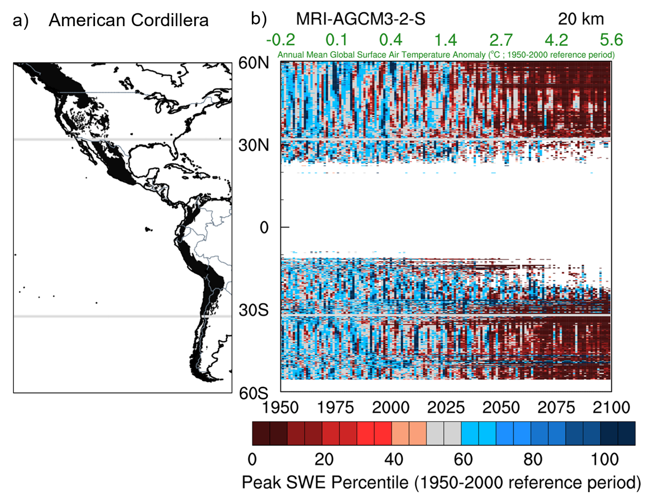
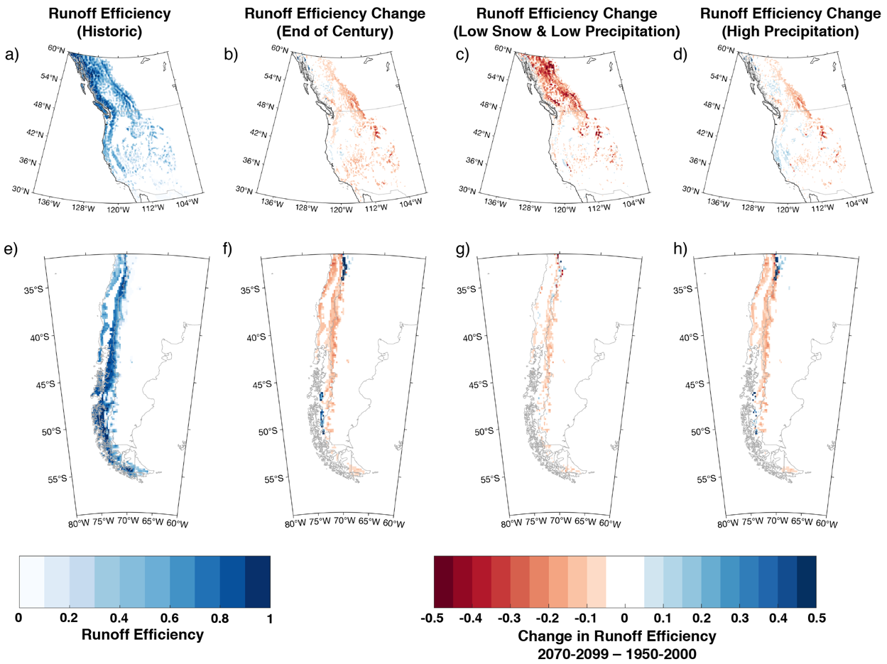



Asymmetric Emergence of Low-to-No Snow in the Midlatitudes of the American Cordillera
Scientific Challenges
Persistent loss of mountain snowpack was found to arise asymmetrically between hemispheres as a result of differences in dynamical, thermodynamical, and hypsometric factors.
Approach and Results
This study suggests different water management strategies need to be adopted between North and South America in response to dwindling snowpack.
Prevention of a low-to-no snow future in either hemisphere requires the level of global warming to be held to at most +2.5ºC.
Significance
Multi-year low-to-no snow (<30th percentile historical peak SWE) conditions are projected to emerge 20 years sooner in the southern hemisphere and at ⅓ of the regional warming level.
Low-to-no snow emergence coincides with runoff efficiency declines (~8% average) in both dry and wet years. Therefore, future dry years will have enhanced drought conditions and wet years will not ameliorate drought as effectively.
Figure (left): Peak snow water equivalent (SWE) percentile versus the 1950-2000 reference period.
(right) Asymmetric changes in runoff efficiency emerge between the Northern and Southern hemispheres under climate change.
Citation: Rhoades, A.M., B.J. Hatchett, M.D. Risser, W.D. Collins, N.E. Bambach, L.S. Huning, R. McCrary, E.R. Siirila-Woodburn, P.A. Ullrich, M.F. Wehner, C.M. Zarzycki, and A.D. Jones “Asymmetric Emergence of Low-to-No Snow in the Midlatitudes of the American Cordillera” Nature Climate Change. DOI: 10.1038/s41558-022-01518-y

