Slide 1
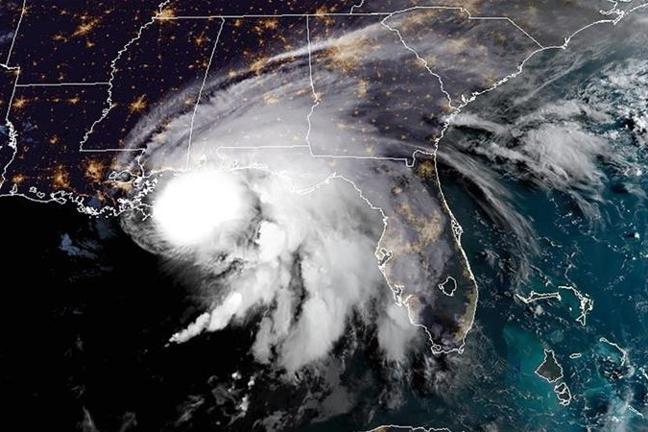
Intensification of Hurricane Sally over the Mississippi River Plume
Objective
Investigate how the Mississippi River plume influenced the intensification of Hurricane Sally (2020) before it made landfall in northern Gulf of Mexico.
Approach
Use satellite observations to understand the prevailing ocean-atmosphere conditions during the intensification of Hurricane Sally before it made landfall as a Category 2 storm on the US Gulf coast.
Conduct experiments with the 1D Price-Weller-Pinkel (PWP) ocean mixed layer model and HYCOM ocean reanalysis to understand the associated ocean processes.
Impact
Hurricane Sally (2020) intensified over the Mississippi River plume as the storm was moving slowly in the northern Gulf of Mexico .
Detailed analysis of ocean-atmosphere conditions suggests that a Loop Current eddy advected fresh Mississippi River water into Sally’s path, enhancing the upper-ocean salinity stratification. This reduced storm-induced sea surface cooling and aided its intensification.
The study suggests that the interaction between the Mississippi River plume and Loop Current eddies, and the resulting salinity stratification, can be an important factor in the intensification of tropical cyclones near the northern Gulf of Mexico.
A)
Image credit : NOAA
B) SST change
C) SSS change
(A) Satellite image of Hurricane Sally approaching the coasts of Alabama. Spatial map of (B) SST and (C) SSS difference between 16 and 12 September from GHRSST and CCI v3.2.1 respectively.
EB John, Balaguru, K., Leung, L. R., G. Foltz, R. Hetland, Hagos, S. M (2023). Intensification of Hurricane Sally (2020) over the Mississippi River Plume. Weather and Forecasting (1391–1404)

