Slide 1
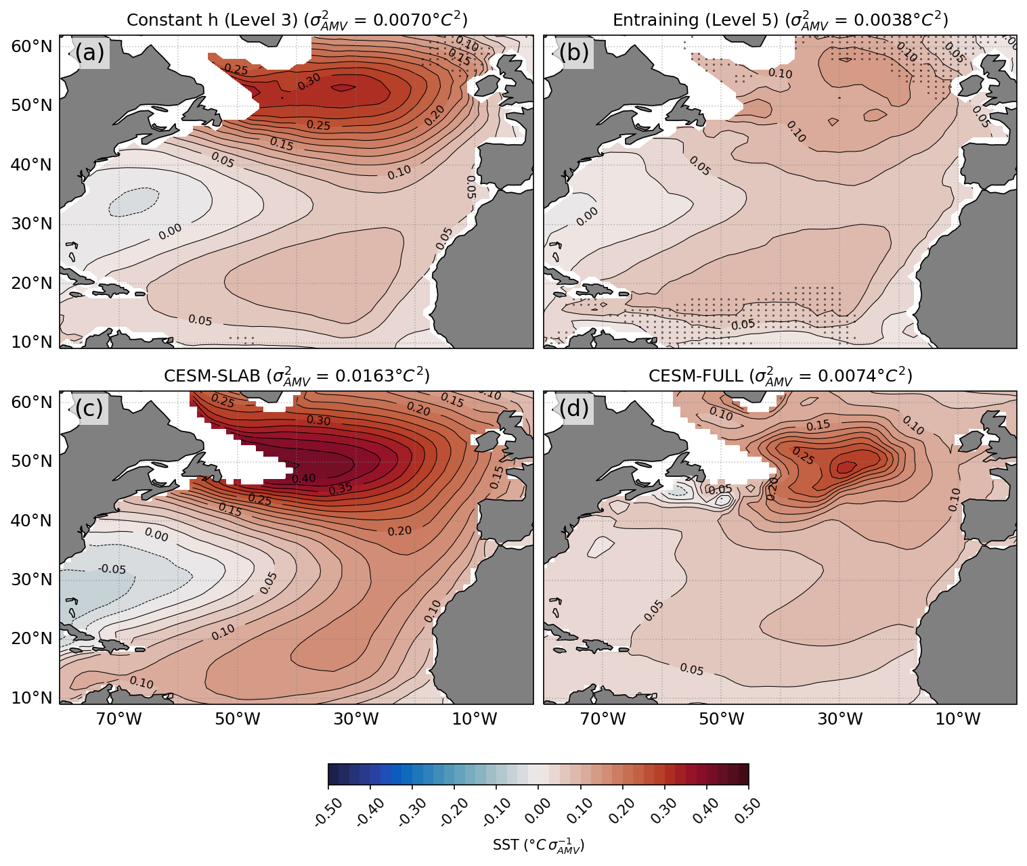
Role of Atmosphere vs. Ocean in Atlantic Multidecadal Variability
Objective
Quantify the relative importance of ocean and atmospheric dynamics in generating Atlantic Multidecadal Variability (AMV).
Approach
Use hierarchy of stochastic climate model to quantify the role of seasonal variation of atmospheric forcing and mixed layer depth (MLD) as well as the mixed layer entrainment.
Compare the stochastic model results with the Community Earth System Model (CESM) simulations using full or slab ocean components.
Impact
In the absence of seasonal MLD variation, CESM slab ocean model simulate unrealistically persistent AMV.
Entrainment acts to damp SST variability at interannual timescales, but enhances variance at decadal timescales.
The canonical AMV horseshoe spatial pattern is primarily driven by the stochastic atmospheric forcing, while the ocean dynamics explain about 50% of the amplitude.
AMV patterns from two different hierarchies of stochastic model (a-b) and CESM with slab ocean (c) and full ocean (d). The stochastic model with constant MLD forced by stochastic atmosphere reproduced the CESM slab ocean AMV (a vs. c). When the entrainment is added to the stochastic model, the AMV pattern become more similar to the CESM with full ocean (b vs. d), but the amplitude is only 50% due to missing ocean dynamics.
Liu, G.*, Y.-O. Kwon, C. Frankignoul, and J. Lu, 2022: Understanding the Drivers of Atlantic Multidecadal Variability using a Stochastic Model Hierarchy. J. Climate, In-press. https://doi.org/10.1175/JCLI-D-22-0309.1.

