Slide 1
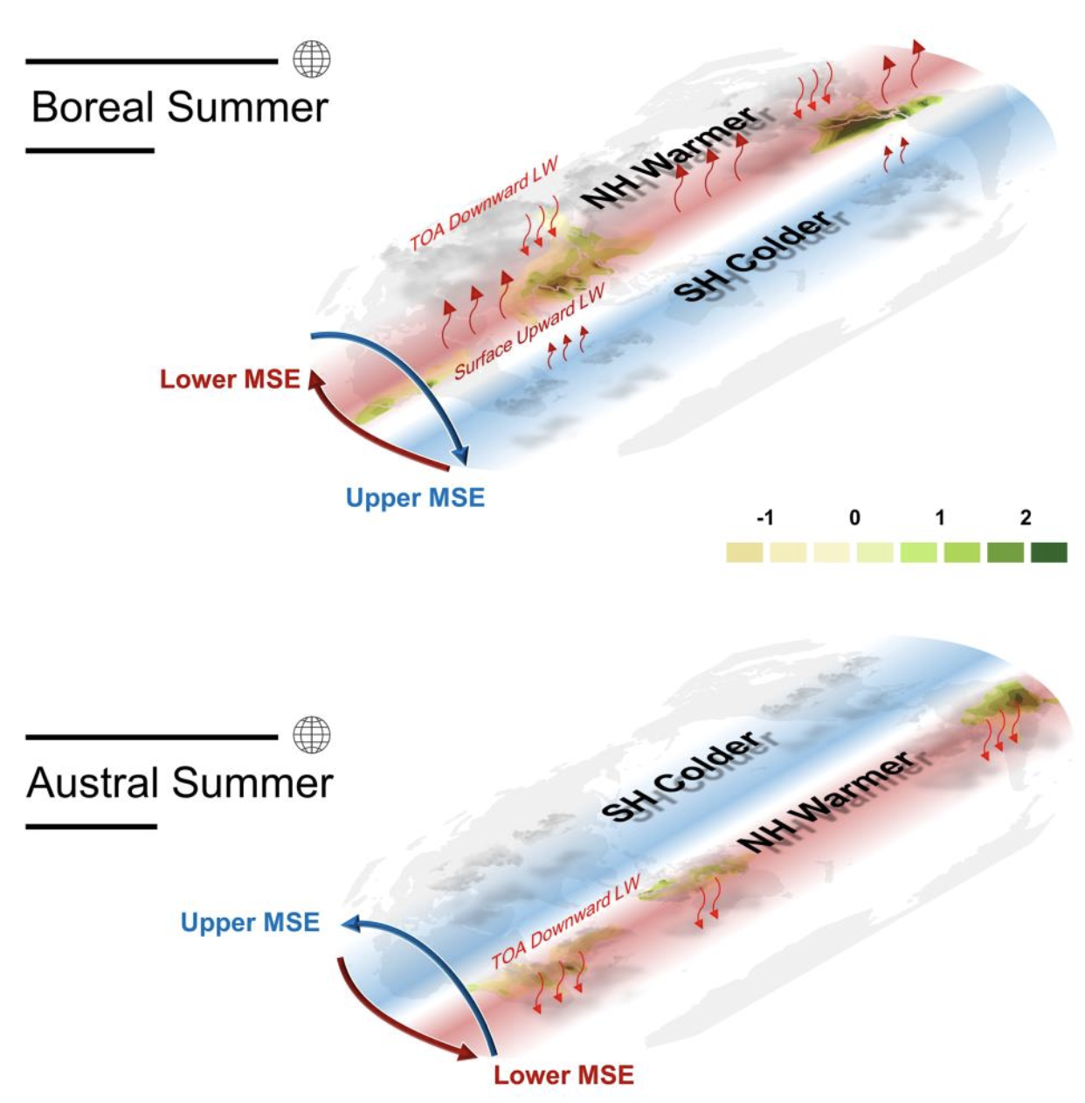
Examining How Energy Transport Affects Global Monsoons in Climate Models
Objective
Develop a diagnostic framework to understand cause of biases in global monsoon (GM) simulations through the lens of interhemispheric energy transport (IET).
Approach
Utilize atmospheric energy balance equation to establish an IET framework, analyzing fundamental processes of IET and its impact on GM simulations:
$AET\left(0\right)=F_{net,ITC}−{\frac{∂\left\langle h\right\rangle }{∂t}}_{ITC}$
Impact
Dry biases in the Northern Hemisphere (NH) summer monsoon precipitation in the Coupled Model Intercomparison Project (CMIP) are reduced by ~11% in CMIP6.
Enhanced simulations of NH summer monsoon in CMIP6 are attributed to reduced negative biases in simulating downward surface longwave radiation and northern energy transport, but there is a persistent wet bias in the SH summer monsoon precipitation across the CMIP6 models.
By demonstrating the connections between model biases in the monsoon and energy transport, this study shows that reasonably reproducing the meridional global atmospheric energy transportation is necessary for skillful GM simulation.
Cross-equatorial energy transport
Interhemispheric contrast of time partial derivative of MSE
Interhemispheric contrast of net energy flux into the column
MSE: Moist Static Energy
NH: Northern Hemisphere
SH: Southern Hemisphere
TOA: top-of-the-atmosphere
LW: longwave radiative flux
Local summer precipitation in both NH and SH monsoon regions is closely linked to IET. During a boreal summer, a pronounced interhemispheric thermal contrast fosters stronger southward (northward) MSE transport in the upper (lower) level, leading to more vigorous monsoon circulation and increased precipitation in the NH. Conversely, during the austral summer, similar processes enhance monsoon activity in the SH. IET is primarily driven by interhemispheric differences in net energy flux into the atmosphere, which are associated with top-of-atmosphere downward longwave flux and surface upward LW flux.
Chen Z., T. Zhou, X. Chen, L. Zhang, Y. Qian, Z. Wang, L. He & L. R. Leung Understanding the biases in global monsoon simulations from the perspective of atmospheric energy transport. J. Climate, (2024). 37, 4647–4666, https://doi.org/10.1175/JCLI-D-23-0444.1.

