Slide 1
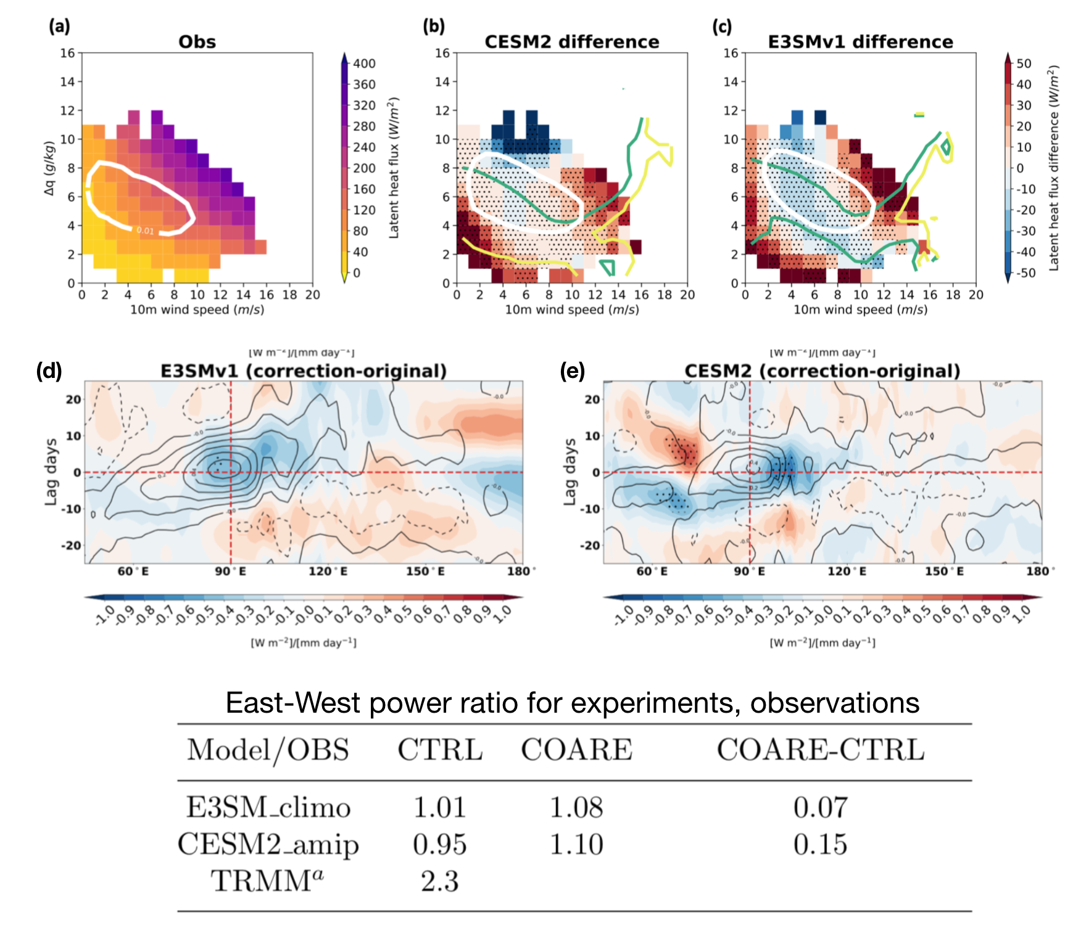
Choice of bulk surface flux algorithm in models may affect MJO simulation skill
Hsu, C.-W., C. A. DeMott, M. D. Branson, J. Reeves Eyre, and X. Zeng, 2022: Ocean Surface Flux Algorithm Effects on Tropical Indo-Pacific Intraseasonal Precipitation. Geophys. Res. Lett., https://doi.org/10.1029/2021GL096968.
Objective
offline adjustment
offline adjustment
Previous work has shown that most bulk surface flux algorithms used in climate models overestimate fluxes by 10-20%, while fluxes estimated using the COARE3.0 algorithm are in good agreement with directly measured fluxes (Brunke et al 2003).
Do biases in flux algorithms negatively impact MJO simulation?
Brunke et al. (2003): https://doi.org/10.1175/1520-0442(2003)016<0619:WBAAAL>2.0.CO;2
Approach
offline adjustment
offline adjustment
A newly developed surface flux diagnostic lets us estimate corrected model fluxes by adjusting model fluxes toward COARE3.0 fluxes based on model bulk inputs of wind, humidity, and temperature (“offline” correction).
We also replace the original bulk flux algorithm with the COARE3.0 algorithm in two climate models (“inline” correction).
Impact
Offline and inline corrections indicate that the original bulk flux algorithms are overly supportive of MJO convection, and under-supportive of MJO propagation. MJO simulation skill in atmosphere-only simulations is improved with COARE3.0 fluxes.
Our surface flux diagnostic has been added to the DOE CMEC diagnostics package.
inline adjustment
Table. Ratios of eastward vs westward power for zonal wave numbers 1-3 and periods 30-60 days for atmosphere-only simulations with both flux algorithms.
Figure. a) latent heat flux as a function of wind speed and near-surface humidity difference (shading) and 0.1% contour of fraction of observations (white contour). b-c) as in a, but estimated flux bias, plus 5 and 10 (green , yellow) mm/day rainfall. d-e) 20-100 day precipitation lag-regression for E3SMv1 and CESM2 (contours) and COARE-minus-original flux differences (shading).

