Slide 1
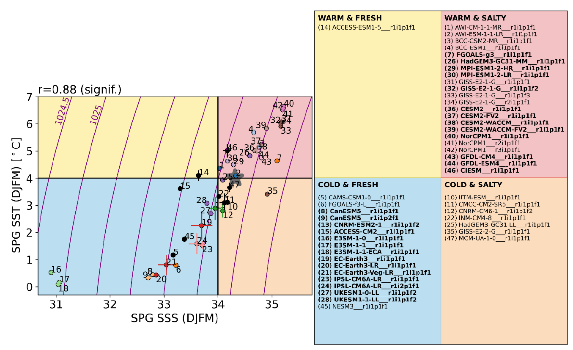
Subpolar North Atlantic mean state affects the response of the Atlantic Meridional Overturning Circulation to the North Atlantic Oscillation in CMIP6 models
A. Reintges, J. I. Robson, R. Sutton, and S. Yeager, 2024: J Climate, https://doi.org/10.1175/JCLI-D-23-0470.1
OBJECTIVE
Elucidate the origins of intermodel spread in the strength of the relationship between NAO and AMOC by contrasting models that show different mean state biases in the subpolar North Atlantic.
APPROACH
Examination of 47 pre-industrial control contributions to CMIP6 revealed a strong relationship between SST/SSS bias in the subpolar gyre (SPG) region. The response to NAO is compared between models categorized as “warm-salty” (including CESM2) and “cold-fresh” (including E3SM1), and the former are shown to simulate a stronger and more long-lasting AMOC response.
IMPACT
This multi-model analysis sheds new light on model structural uncertainty in simulating Atlantic variability by demonstrating that mean state bias in both temperature and salinity is relevant for understanding why different models simulate different NAO-AMOC linkages. The “spiciness” perspective is novel and effective because 1) it can explain a large fraction of intermodel spread in the mean state, and 2) it captures the dual effects of temperature and salinity in preconditioning the ocean to respond to NAO.
Atlantic subpolar gyre (50° – 65° N, 65°– 25° W) mean winter ocean surface temperature (y-axis) and salinity (x-axis) from CMIP6 pre-industrial control simulations. The 1960-2022 observed value (from EN4) is shown by the star. Models categorized as “cold-fresh” or “warm-salty” were used for analysis.

