Slide 1
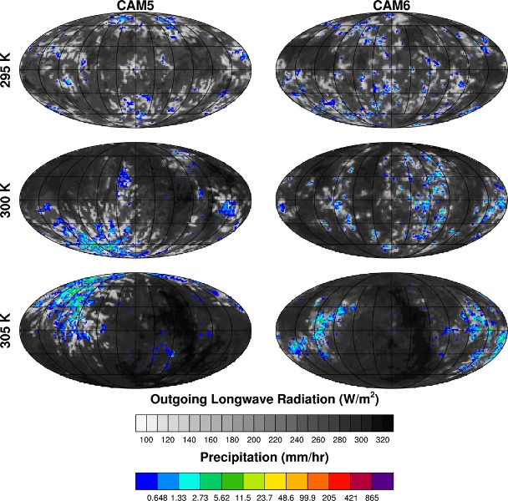
Using Radiative Convective Equilibrium to Explore Clouds and Climate in the Community Atmosphere Model
Kevin A. Reed, Levi G. Silvers, Allison A. Wing, I-Kuan Hu, B. Medeiros J. Adv. Modeling Earth Sys., https://doi.org/10.1029/2021MS002539
Objective
Compare and contrast models solutions of radiative-convective equilibrium in the Community Atmosphere Model versions 5 and 6.
Approach
Develop and document CESM compsets appropriate for RCEMIP.
Run CAM5 and CAM6 in RCE for 3 different specified surface temperatures.
Describe and compare the circulation, moisture, precipitation, and clouds between the models and with prescribed warming.
Compare results, including climate sensitivity, with realistic configurations of CESM.
Impact
This paper documents new modeling capabilities released in CESM2, namely the inclusion of a RCE compset that can be run using the standard CESM workflow.
CAM5 simulates higher precipitation rates that result in larger global average precipitation, despite lower outgoing longwave radiation compared to CAM6.
Anvil clouds rise and decrease in coverage with warming while extreme precipitation strengthens and convective aggregation increases.
Differing parameterizations lead to a reduction of low-level clouds in CAM6, consistent with differences in more realistic simulations
Hourly averaged snapshot of outgoing longwave radiation (gray shading) and total precipitation rate (color shading) from the last day of the three CAM5 (left) and CAM6 (right) RCE simulations with SSTs of 295 K, 300 K, and 305 K. Note, for comparison purposes the colorbars used match those in Wing et al. (2018), which introduced the RCEMIP protocols.

