Slide 1
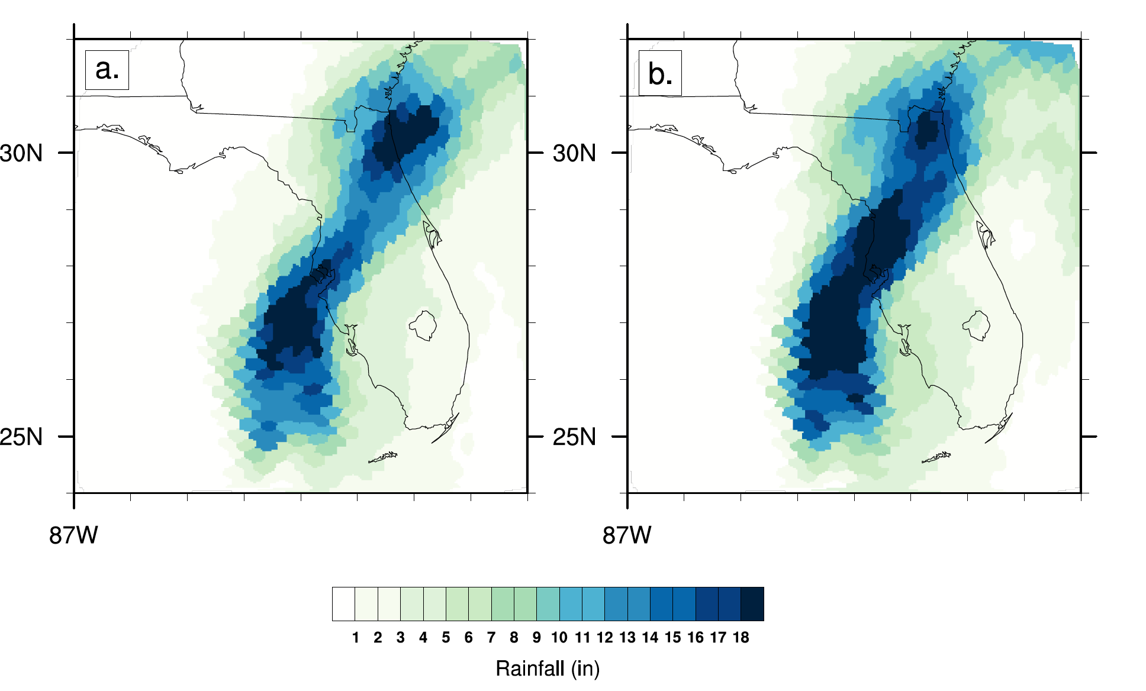
Real-time attribution of the influence of climate change on extreme weather events: A storyline case study of Hurricane Ian rainfall
As the Earth continues to warm due to human greenhouse gas emissions, there is a growing need to efficiently communicate the effect that global warming has on individual extreme weather events. Using a storyline approach, we present a rapid attribution of the increase in rainfall over Florida during Hurricane Ian in 2022 due to climate change as a case study.
Using a previously developed and tested hindcast attribution methodology applied to the 2020 Atlantic Hurricane season, we demonstrated in near real-time that storyline rapid assessments of individual tropical cyclones can be completed during an event. Such rapid assessment offers scientists a useful tool in answering questions about the climate change effect on individual extreme weather events as they unfold.
Ensemble average 3-day accumulated rainfall in inches (in) for the Hurricane Ian for CAM forecasts initialized on September 27, 2022 at 12Z for the (a) counterfactual and (b) actual ensembles.
Using a previously developed and tested hindcast attribution methodology applied to the 2020 Atlantic Hurricane season, we demonstrated in near real-time that storyline rapid assessments of individual tropical cyclones can be completed during an event. Such rapid assessment offers scientists a useful tool in answering questions about the climate change effect on individual extreme weather events as they unfold.
Kevin Reed, Michael Wehner (2023) Real-time attribution of the influence of climate change on extreme weather events: A storyline case study of Hurricane Ian rainfall. Environmental Research: Climate. 2 043001, DOI 10.1088/2752-5295/acfd4e

