Slide 1
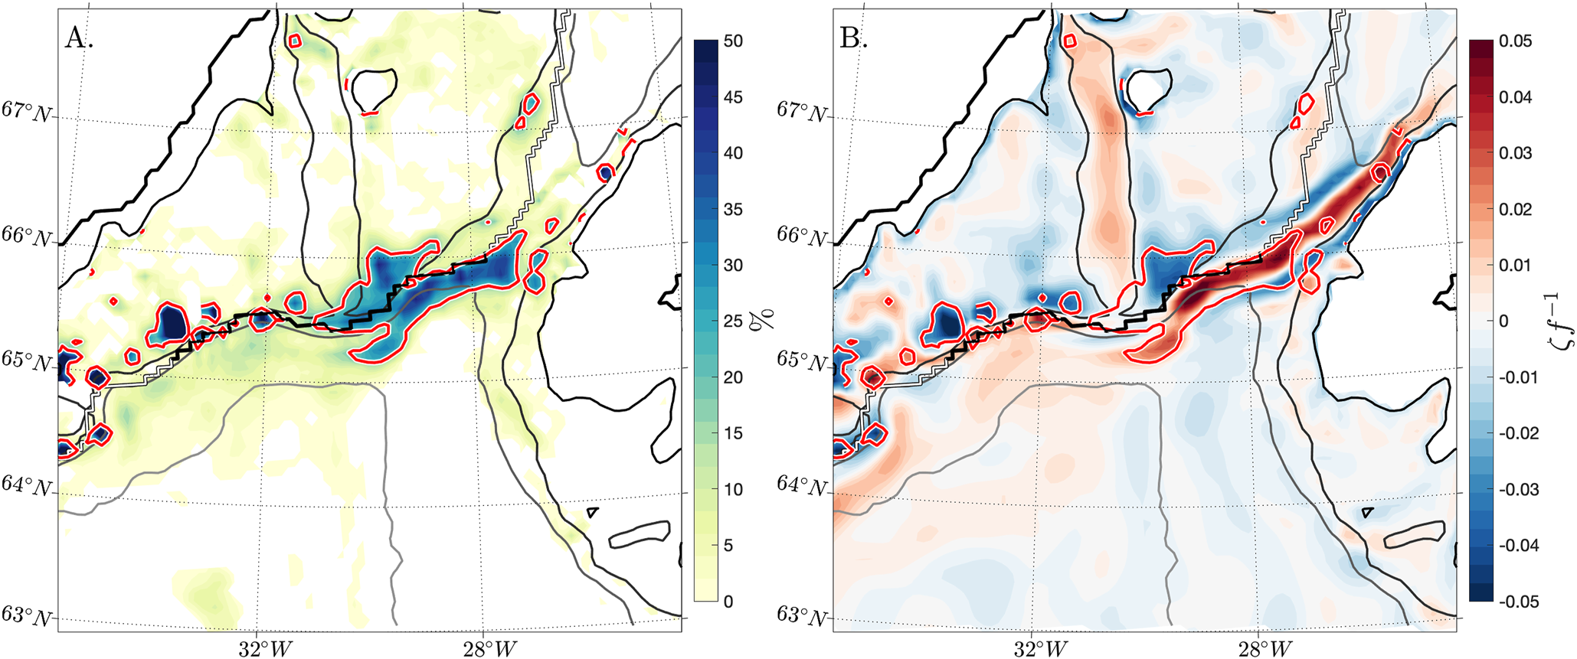
Mechanisms of Heat Flux Across the Southern Greenland Continental Shelf in 1/10º and 1/12º Ocean/Sea Ice Simulations
Objective
Use two coupled ocean-sea ice simulations: global 1/10º Parallel Ocean Program (POP) & the 1/12º HYbrid Coordinate Ocean Model (HYCOM) to understand the magnitudes, variability and causes of heat flux crossing onto the southern Greenland continental shelf.
Green-land
Iceland
Approach
Compare Greenland continental shelf currents & water masses from the two simulations & observations.
Compare mean and eddy along- and cross-shelf components of heat flux in segments around the southern Greenland shelf in the two models.
Examine the nature of multi-day oscillations of on-shelf heat flux along the southeast Greenland shelf found in both models.
Denmark Strait Overflow (DSO) region in POP; contours of 200, 400, 800, & 2000 m isobaths are in gray. (a) Percent of days in 2005 when eddies are present at 200 m; red contour surrounds areas where the probability of an eddy being present is >25%. (b) Nondimensional relative vorticity at 200 m for 2005. Red contour from (a) is superimposed indicating that coherent negative vorticity features (anticyclonic) on the shelf are likely mesoscale eddies. Along shelf transect is white; DSO eddy formation region is in black.
Impact
On-shore heat flux over the southeastern Greenland shelf has been implicated in melting at the margins of the Greenland Ice Sheet. Knowledge of the strength and variability of these on-shore heat fluxes, coupled with an understanding their governing processes, can be used to understand where and how heat is delivered to the Greenland fjords.
Morrison, T.J., D.S. Dukhovskoy, J. L. McClean, S.T. Gille, & E.P. Chassignet (2023) Mechanisms of Heat Flux Across the Southern Greenland Continental Shelf in 1/10º and 1/12º Ocean/Sea Ice Simulations. J. Geophys. Res. Oceans, 128, e2022JC019021, doi: 10.1029/2022JC019021.

