Slide 1
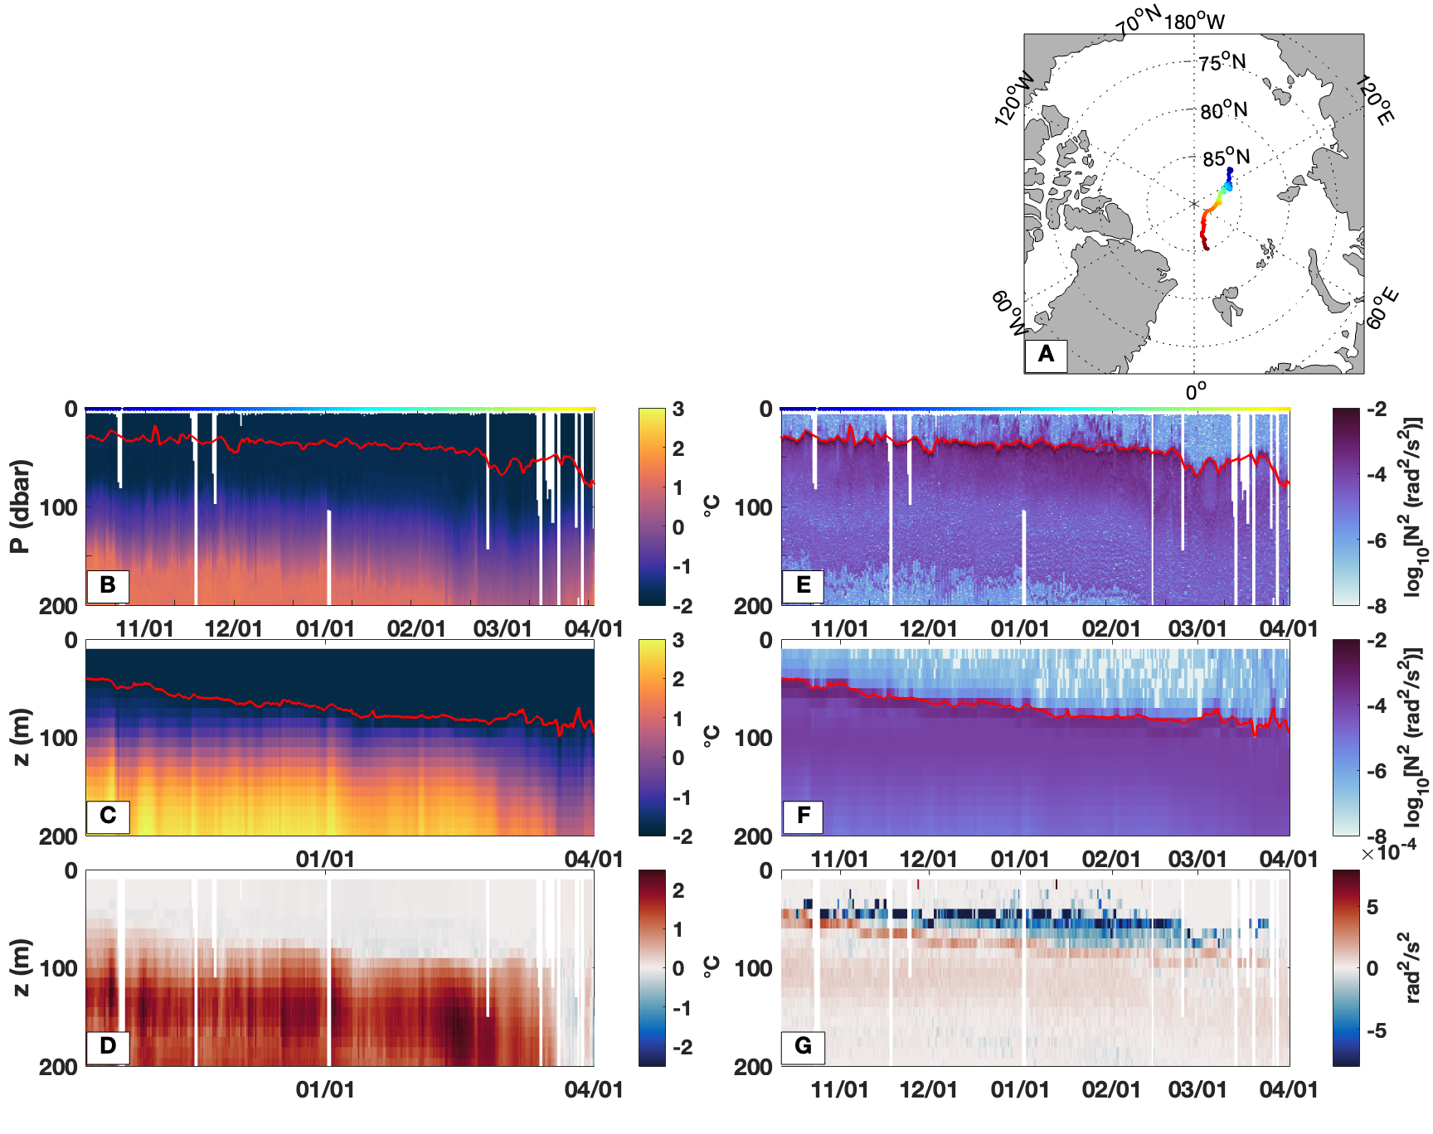
Arctic Ice-Ocean Interactions in an 8-2 Kilometer Resolution Global Model
Objective
Use a new atmospheric reanalysis forced ultrahigh (~2-4 km in Arctic) resolution global ocean-sea ice model to investigate the influence of the upper Arctic ocean on Arctic sea ice during 2017-2020.
Impact
Declining sea ice in the rapidly warming Arctic induces ocean-sea ice feedbacks that further perpetuate sea-ice loss.
ITP #111 section in the eastern Arctic
Approach
Validate simulation with metrics based on satellites & in-situ observations from ice-tethered profilers (ITPs) and current meter arrays, hydrographic climatology, & Arctic State Estimate.
Understand the role of the upper-ocean in sea-ice coverage biases.
Determine impacts of sea-ice/ocean feedbacks e.g., excessive summer melt & then refreezing leading to excessive brine rejection & oceanic convective mixing, potentially bringing warm sub-surface Atlantic Water into the mixed layer and in contact with sea-ice.
a) Map of ITP deployment, b) observed & c) modeled temperature (°C) along ITP deployment, d) model-observed temperature difference (°C), e) observed and f) modeled buoyancy frequency (rad²s⁻² ), g) model-observed buoyancy frequency difference (rad rad²s ⁻²). Mixed layer depth (MLD): red lines in panels b, c, e, and f. Colors corresponding to locations in panel a) are plotted across the tops of b) and e). Model is warmer below the MLD than observed; MLDs are deeper & stratification is lower in the model relative to observations.
Fine, E.C., J.L. McClean, D.P. Ivanova, A.P. Craig, A.J. Wallcraft, E.P. Chassignet, E. Hunke, 2023. Arctic Ice-Ocean interactions in an 8-2- kilometer resolution global model. Ocean Modelling, 102228, 10.1016/j.ocemod.2023.102228

